Slide 1


Presentation on:
Identifying Influential Biomarkers of Colorectal Cancer using Bioinformatics and Machine Learning approaches with Explainable AI
Defense
Presented by:
Farhana Akter Suci
Rifah Sajida Deya
Department of Computer Science and Engineering,
Jagannath University, Dhaka
Supervised by:
Dr. Mohammed Nasir Uddin
Professor,
Department of Computer Science and Engineering,
Jagannath University, Dhaka
25th August, 2025
Department Of Computer Science and Engineering, JnU
1

Slide 2



Outlines
5
1
Result Evaluation
Introduction
6
Model Interpretation
2
Research Goal
7
Gene Validation & Immune Infiltration Analysis
3
Related Works
8
Comparative Study
4
Proposed Methodology
9
Conclusion
Department Of Computer Science and Engineering, JnU
2

Slide 3
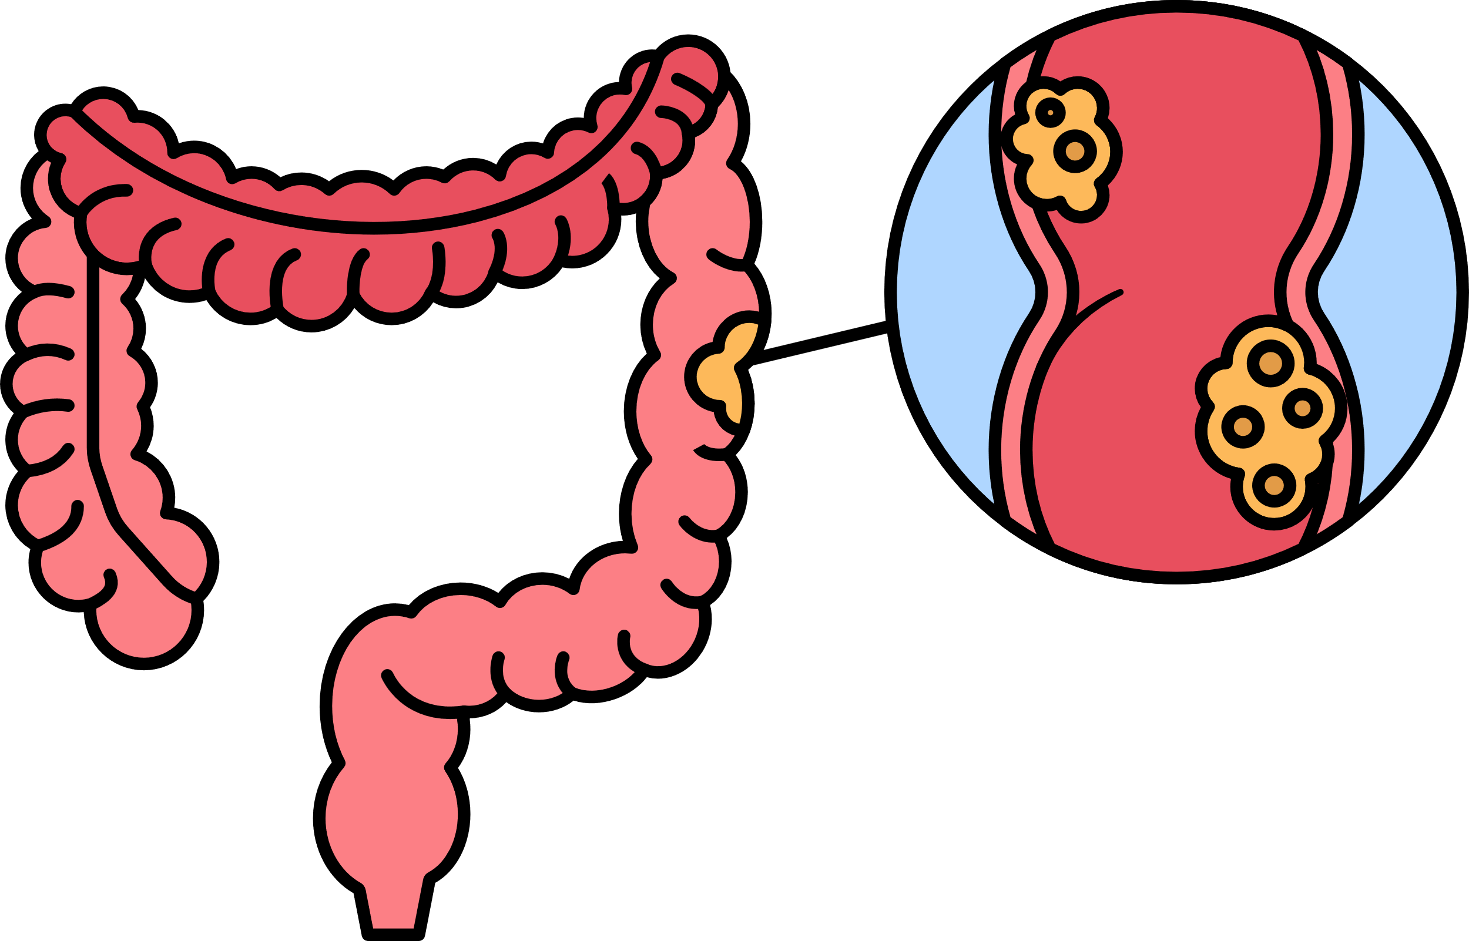
Introduction
Colorectal cancer (CRC), also known as bowel cancer, colon cancer, or rectal cancer, is the development of cancer from the colon or rectum (parts of the large intestine).
Most colorectal cancers are due to lifestyle factors and genetic disorders.
Department Of Computer Science and Engineering, JnU
3

Slide 4
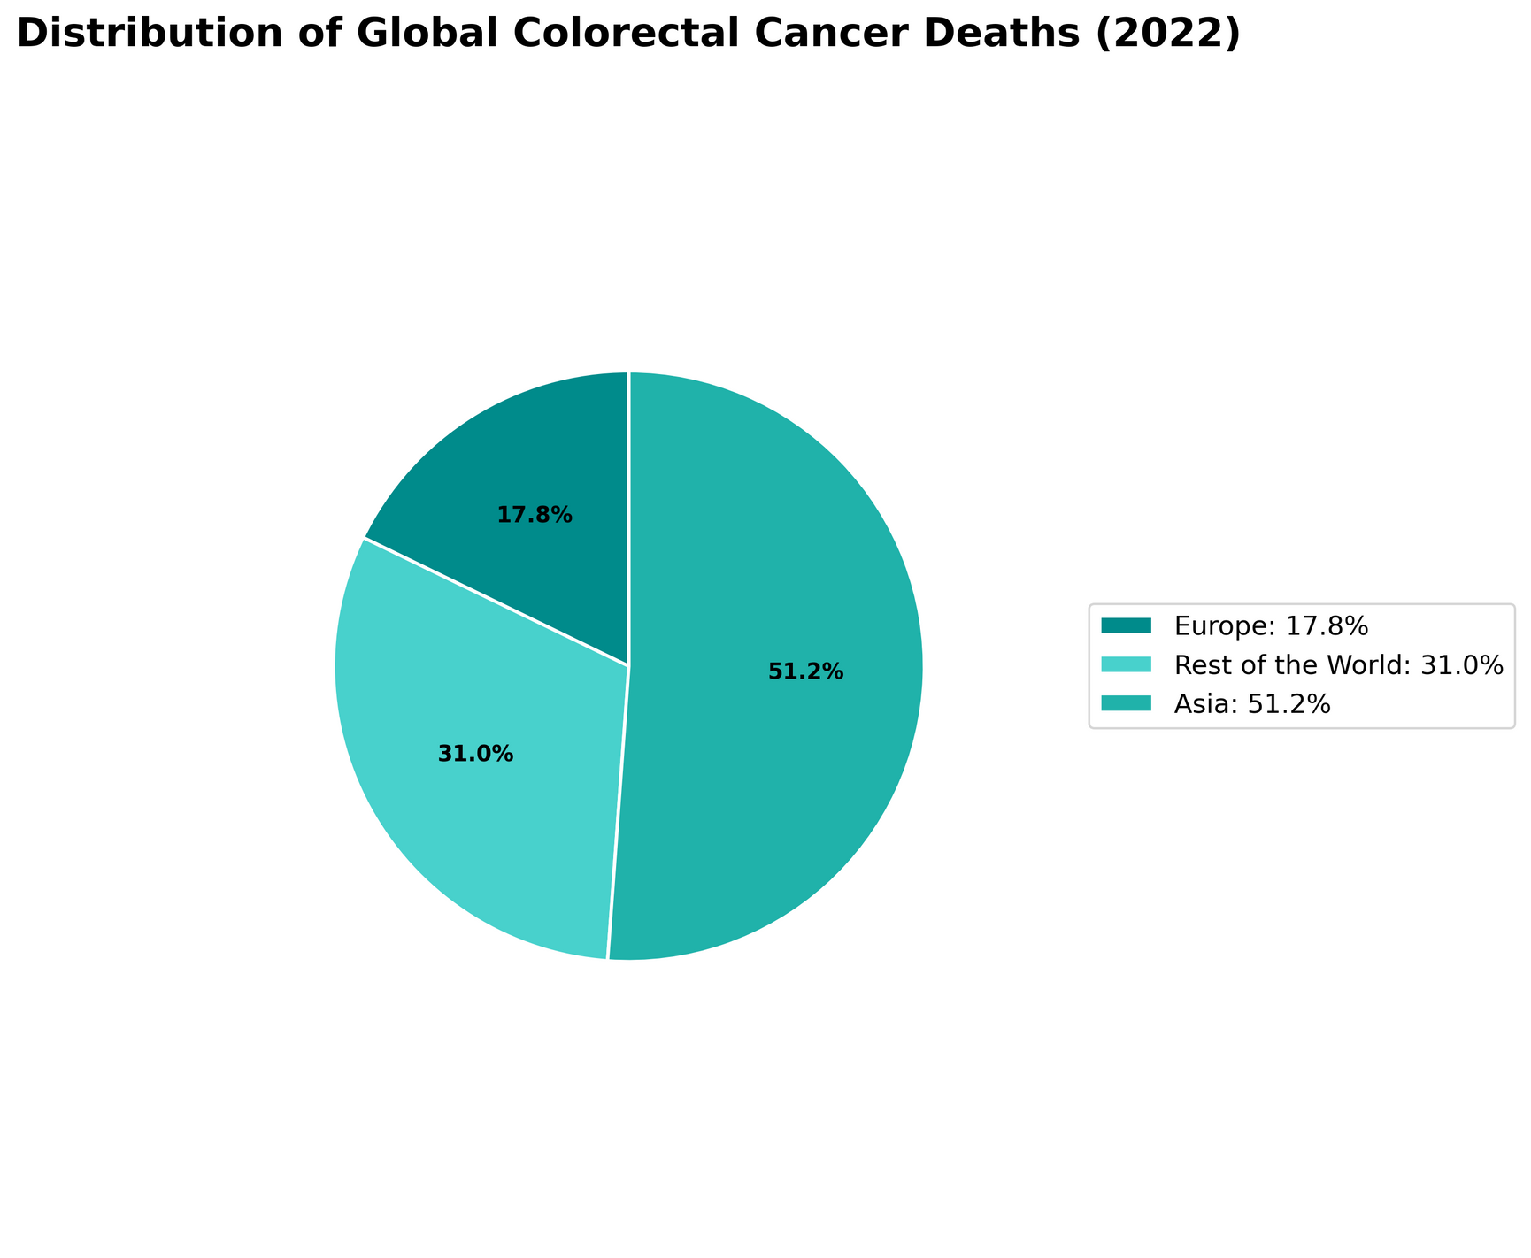
Introduction (cont..)
According to GLOBOCAN recent study shows that, almost 1.93 million people were diagnosed with colorectal cancer and approximately 9,35,000 people died worldwide [1].
Asia was home to approximately 9,66,400 colorectal cancer cases and 4,62,300 deaths—almost half of the global burden. On the other hand, Europe had 3,61,986 colorectal cancer cases and 1,61,182 deaths. [2]
Figure 1.1 : Distribution of Global Colorectal Cancer Deaths
Department Of Computer Science and Engineering, JnU
4

Slide 5

Research Goal
Create a reusable pipeline for colorectal cancer biomarker discovery using bioinformatics and machine learning approaches.
Test the biomarkers on different datasets to check their accuracy and reliability.
Apply Explainable AI (e.g., SHAP) to understand how each selected gene affects the model’s predictions.
Validate the gene biomarkers by GEPIA2 and perform immune infiltration analysis to examine their prognostic value and links to immune cell presence in tumors.
Department Of Computer Science and Engineering, JnU
5

Slide 6
Related Works
Authors | Methods/Models | Accuracy
Radhakrishnan et al. [6] | LASSO, XGBoost, LightGBM, SHAP | 94.87%
Minh et al. [4] | SVM, DNN, KNN, RF, NB | 94%
Bera et al. [7] | Bioinformatics approaches, SVM, LR, KNN, RF, XGBoost | 97%
Yoon et al. [8] | Hybrid Bioinformatics approach | 98.69% (AUC)
Vaziri-Moghadam et al. [3] | RF, SVM, ANN | 95.8% , 97.8%
Hasan et al. [9] | WGCNA, SVM | 98% (AUC)
Wei et al. [5] | SVM, XGBoost, RF, KNN | 96.4% , 98.2%
Du et al. [10] | Hybrid bioinformatics approach | 77% (AUC)
Table 3.1 : Recent Related Works on Identifying CRC Biomarkers
Department Of Computer Science and Engineering, JnU
6

Slide 7
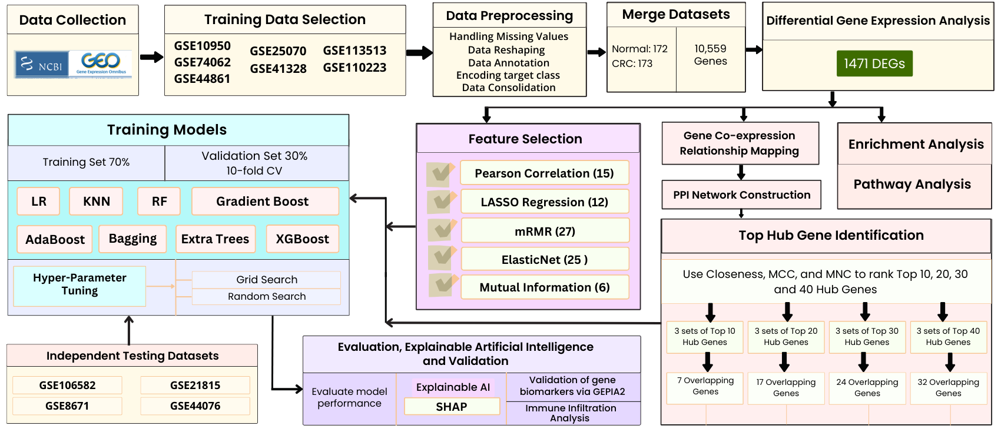
Proposed Methodology
Figure 4.1: Workflow of the proposed methodology
Department Of Computer Science and Engineering, JnU
7

Slide 8
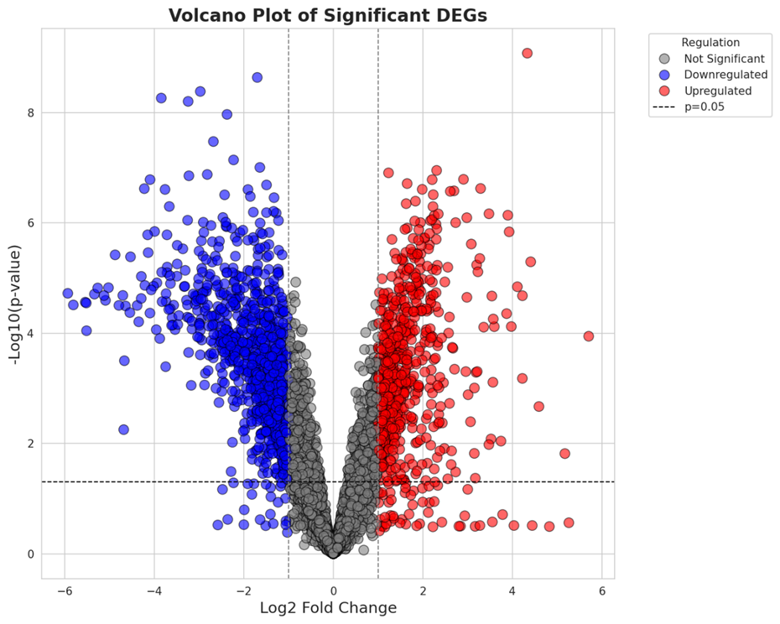
Proposed Methodology (cont..)
Differential Gene Expression Analysis:
Total significant genes found 1471
There were 564 upregulated and 907 downregulated genes.
Figure 4.2: Volcano Plot on DEGs
Department Of Computer Science and Engineering, JnU
8

Slide 9
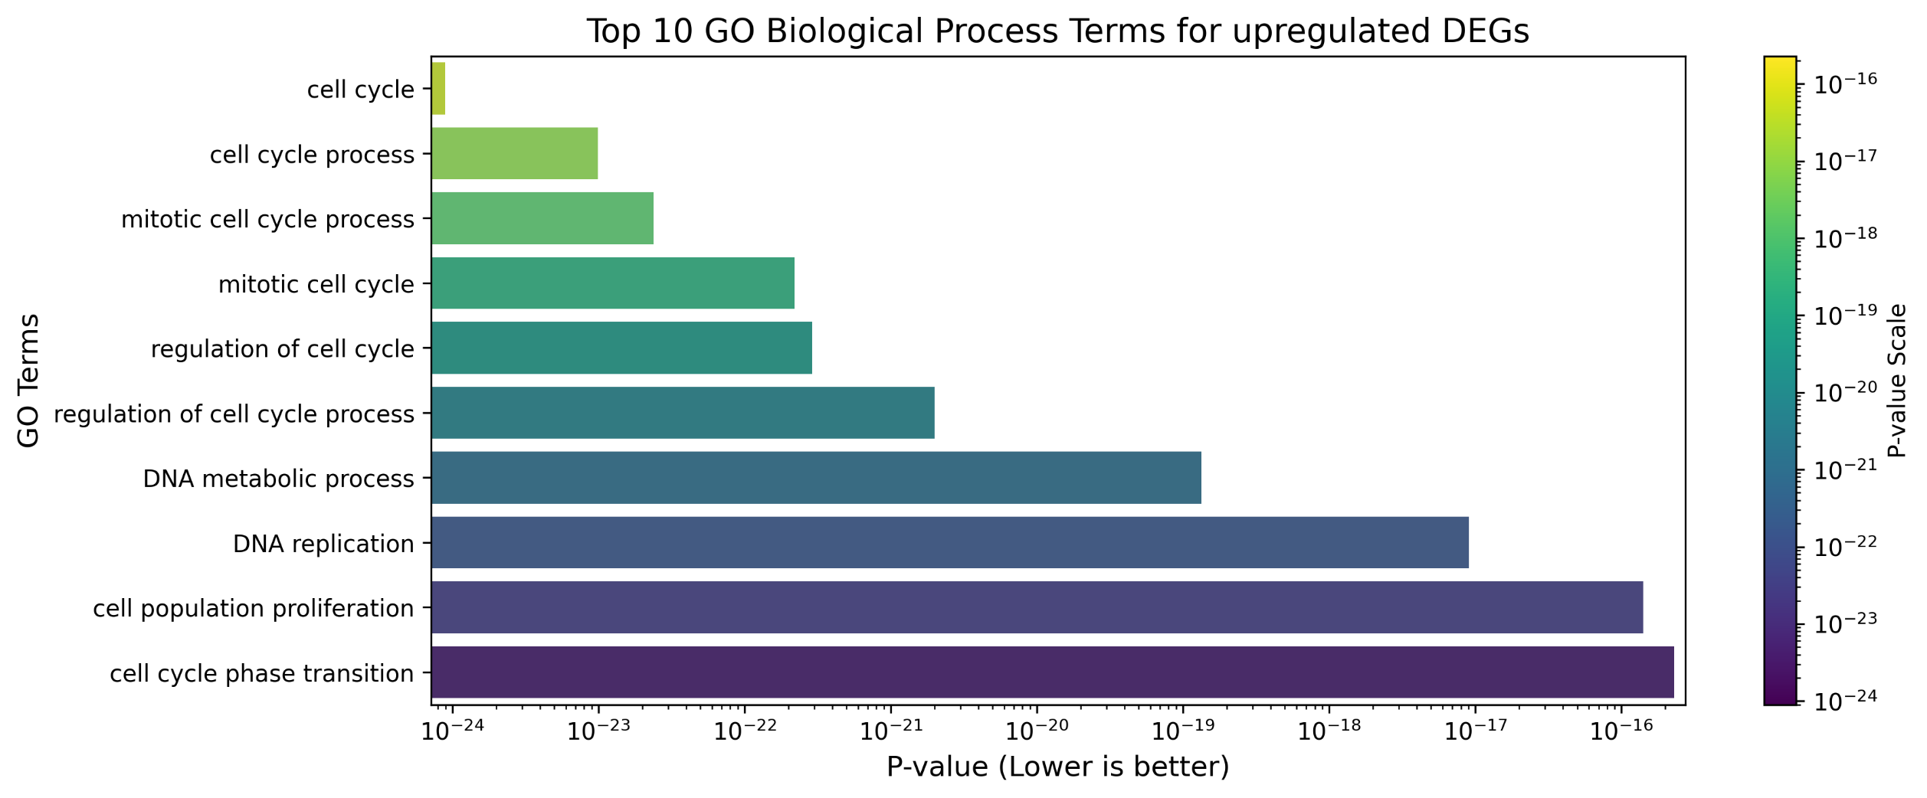
Proposed Methodology (cont..)
Gene Enrichment and Pathway Analysis
Gene Enrichment Analysis:
Gene Ontology (GO) enrichment analysis was performed separately on the upregulated and downregulated DEGs to identify the most significantly overrepresented biological terms in three GO categories:
Biological Process (BP),
Molecular Function (MF), and
Cellular Component (CC).
Figure 4.3: Top 10 GO biological process terms for upregulated DEGs
Department Of Computer Science and Engineering, JnU
9

Slide 10
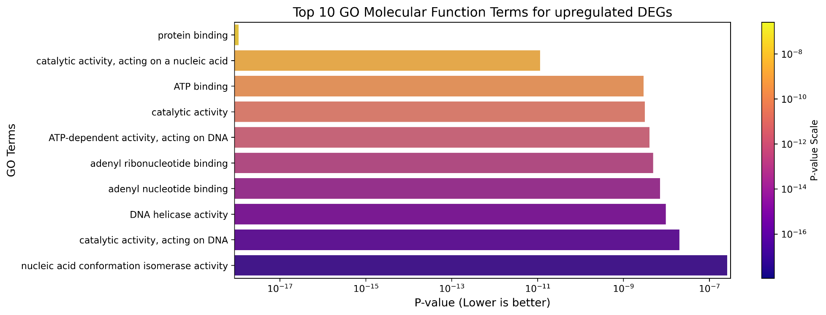
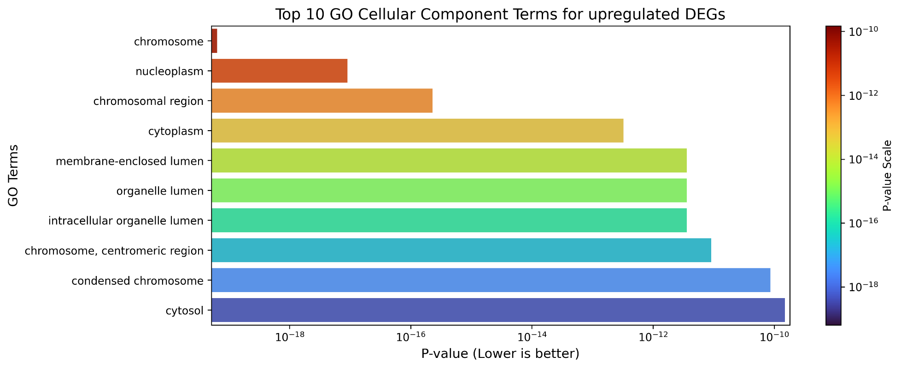
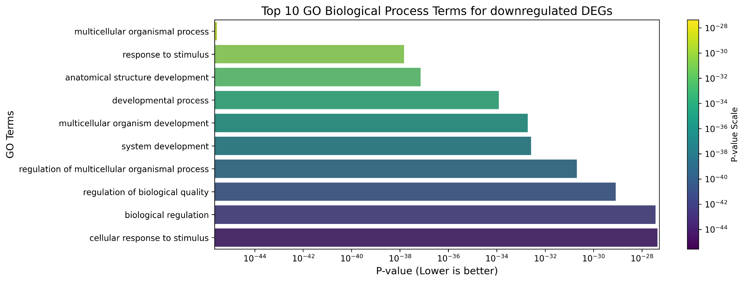
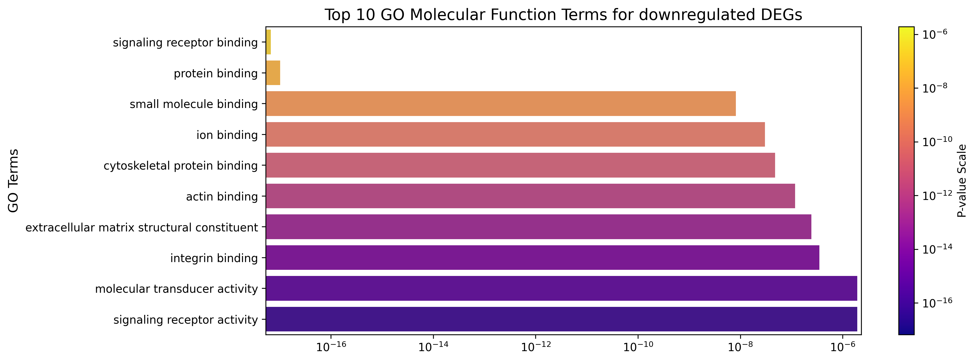
Proposed Methodology (cont..)
Figure 4.4: Top 10 GO terms for upregulated and downregulated DEGs
Department Of Computer Science and Engineering, JnU
10

Slide 11
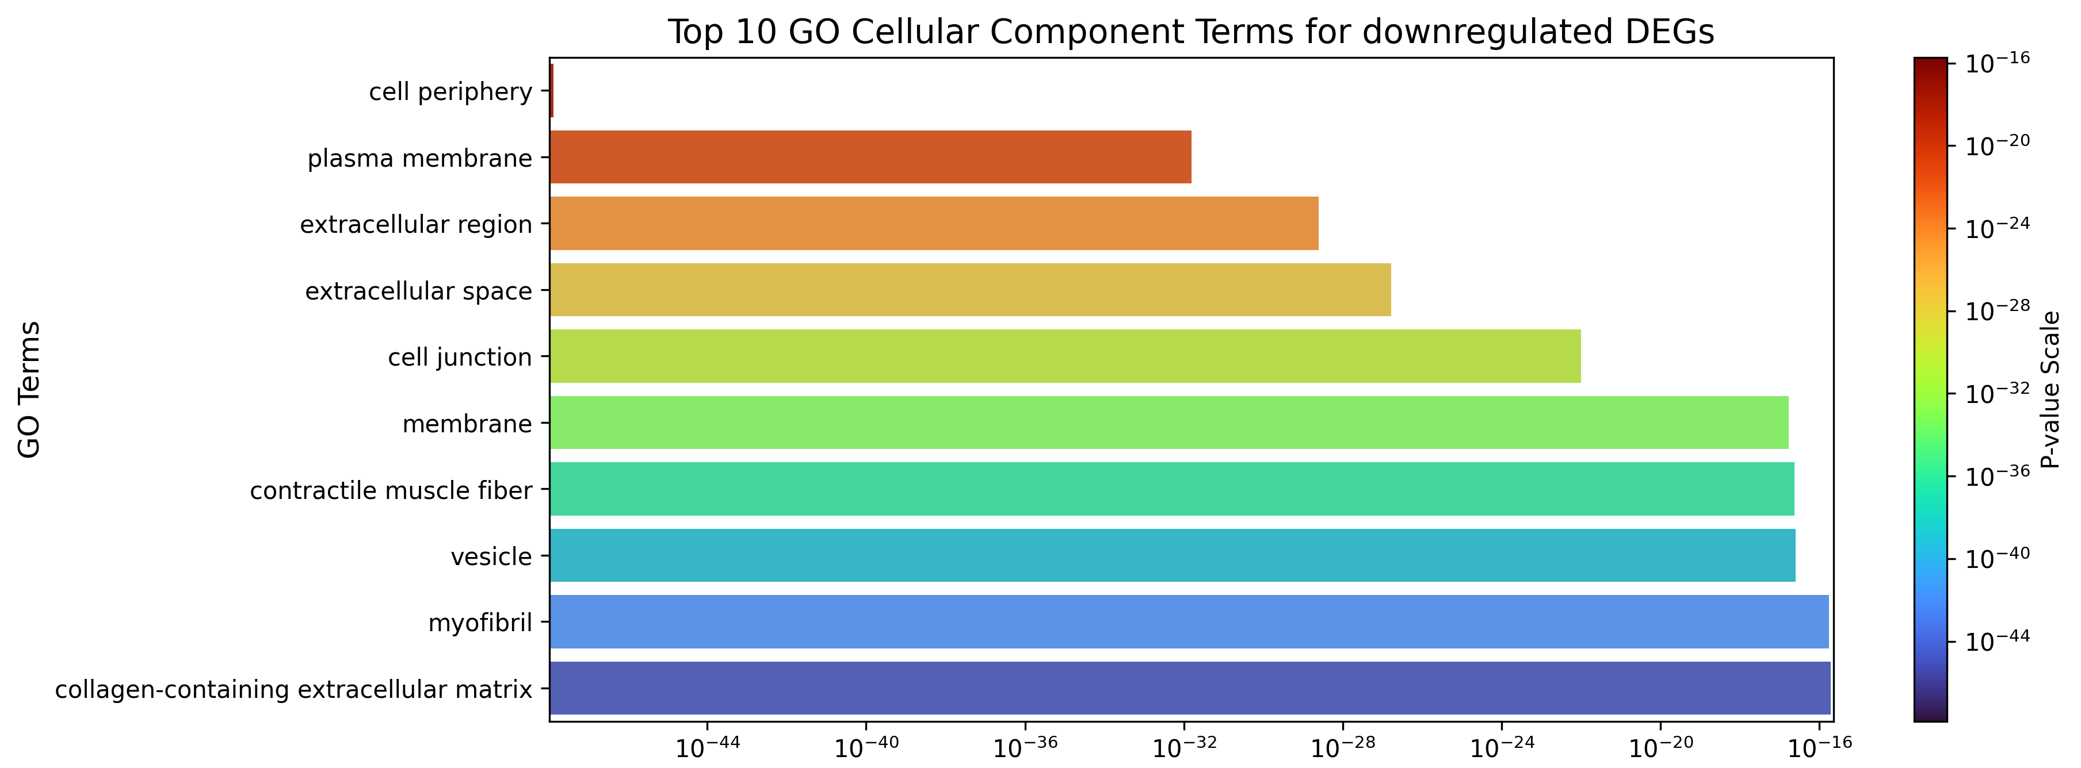
Proposed Methodology (cont..)
Figure 4.5: Top 10 GO cellular components terms for downregulated DEGs
Gene Pathway Analysis:
Gene pathway analysis was performed separately on the upregulated and downregulated DEGs to identify biological terms in two categories:
Kyoto Encyclopedia of Genes and Genomes (KEGG),
Reactome Pathway Database (REAC)
Department Of Computer Science and Engineering, JnU
11

Slide 12
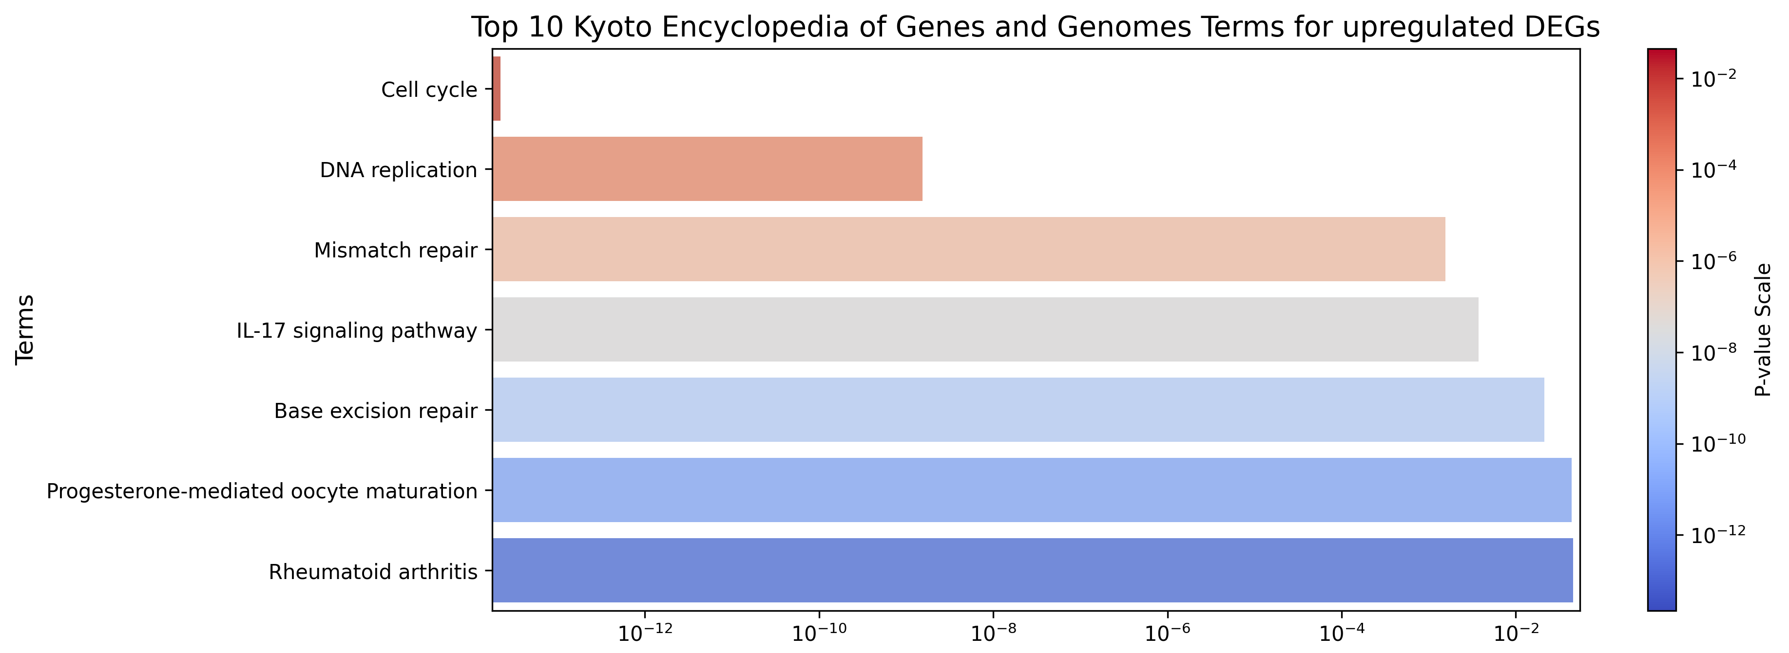
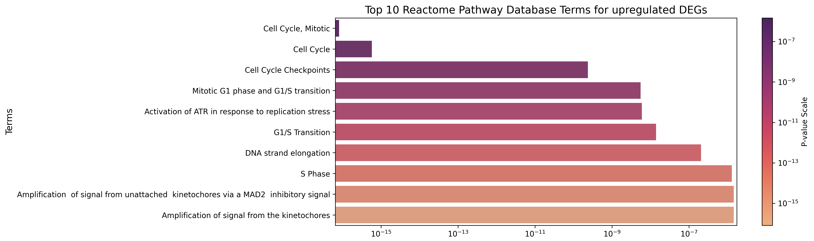
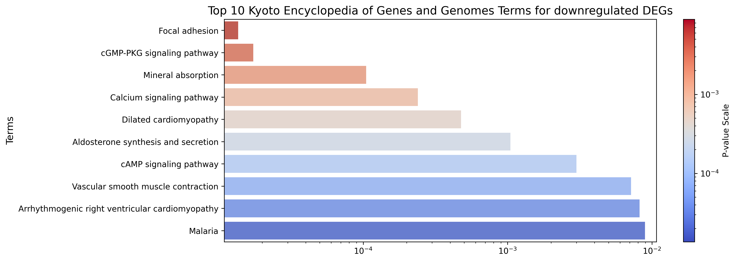
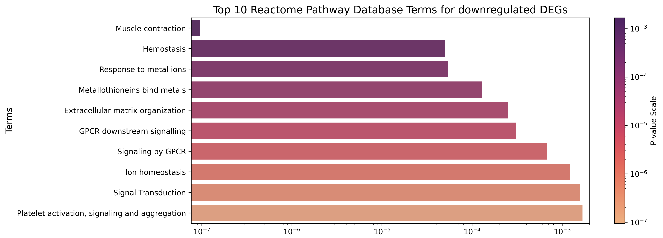
Proposed Methodology (cont..)
Figure 4.6: Top KEGG and REAC terms for upregulated and downregulated DEGs
Department Of Computer Science and Engineering, JnU
12

Slide 13
Proposed Methodology (cont..)
Gene Co-expression Relationship Mapping
In this part an adjacency matrix was constructed where edges exist if correlation > 0.8 (absolute value). Then mapped a gene co-expression relationship using this adjacency matrix.
Calculated degree centrality for each gene (i.e., number of strong connections it has).
Selected the top 100 genes with the highest degree centrality — these are the most "hub-like" genes in the network.
Department Of Computer Science and Engineering, JnU
13
Department Of Computer Science and Engineering, JnU

Slide 14
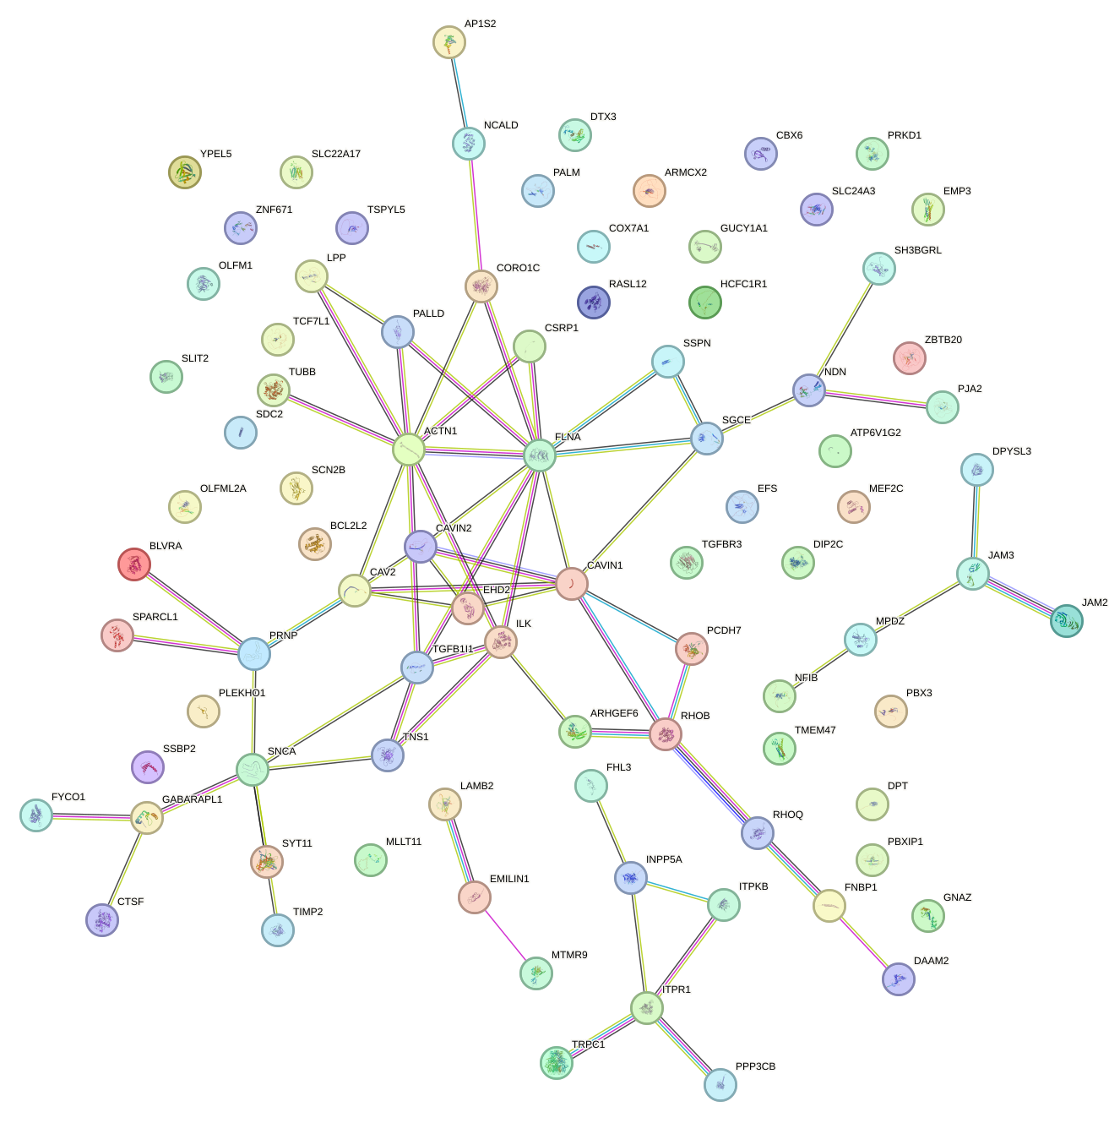
Proposed Methodology (cont..)
PPI network Construction
After gene co-expression relationship mapping, the Protein-Protein Interaction network was drawn.
88 genes were obtained by this approach.
Top Hub Genes Identification
88 genes were found in the previous step, then in this step 3 ranking methods were used. Closeness, MCC and MNC. For each method, the top 10, 20, 30 and 40 genes were evaluated. So, for each method, 4 sets of genes were obtained.
Figure 4.7: PPI Network
Department Of Computer Science and Engineering, JnU
14

Slide 15
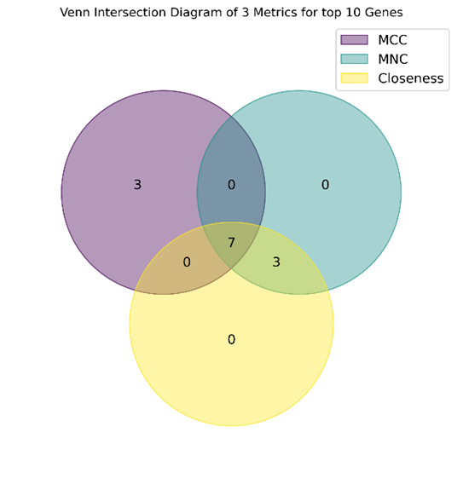

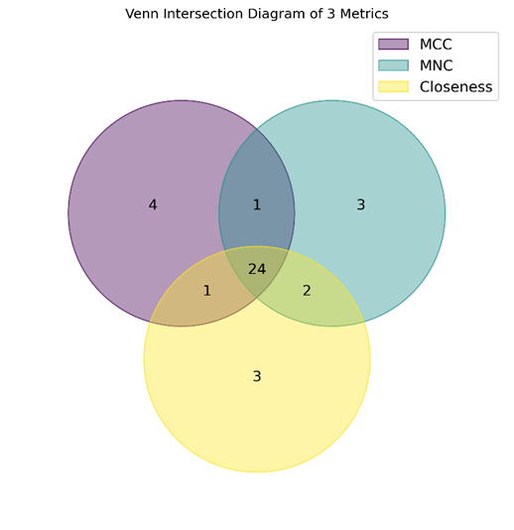

Proposed Methodology (cont..)
Figure 4.8: Venn Diagram of 3 ranking methods of top 10 genes
Figure 4.9: Venn Diagram of 3 ranking methods of top 20 genes
Figure 4.10: Venn Diagram of 3 ranking methods of top 30 genes
Figure 4.11: Venn Diagram of 3 ranking methods of top 40 genes
Department Of Computer Science and Engineering, JnU
15

Slide 16
Proposed Methodology (cont..)
After evaluating the 4 set of hub genes, we sent them for machine learning and ensemble learning training.
Feature Selection
In this step 5 feature selections were applied in our DEGs and then we found 5 set of features (gene signatures).
Feature Selection
Pearson Correlation
ElasticNet
LASSO Regression
mRMR
Mutual Information
Figure 4.12: Feature selection methods and quantity of the features with each method
Department Of Computer Science and Engineering, JnU
16

Slide 17

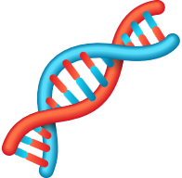
Proposed Methodology (cont..)
Training Models
Hyper-Parameter Tuning
Independent Test Datasets
Training Set 70%
LR
AdaBoost
GSE106582
KNN
Bagging
GSE21815
Extra Trees
Validation Set 30%
Grid Search
RF
GSE8671
Gradient Boost
XGBoost
Random Search
10-fold (Cross validation)
GSE44076
Figure 4.13: Training and Testing phase
As previously mentioned, 4 independent test datasets were used. At first the training and testing were performed with base models. Then the models were trained and tested with hyper-parameter tuning .
After all this phase, the evaluation part started.
Department Of Computer Science and Engineering, JnU
17
Department Of Computer Science and Engineering, JnU

Slide 18
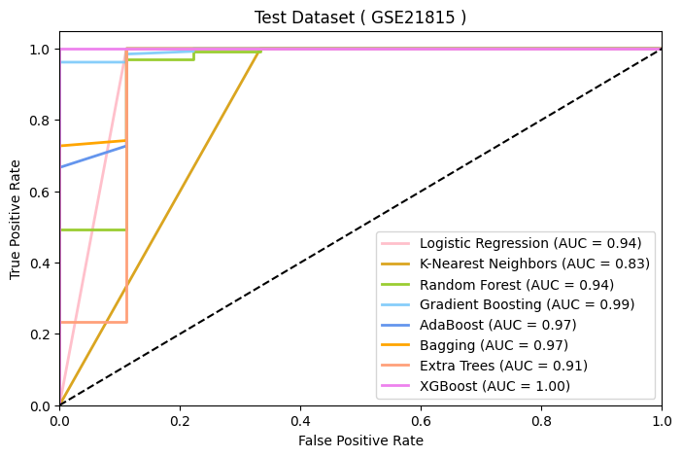
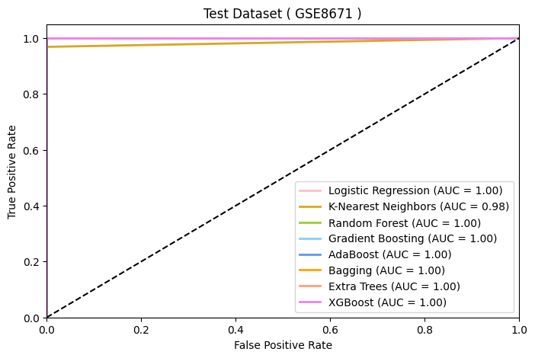
Result Evaluation
Figure 5.1: AUC-ROC curve for Gene subsets (6 genes) for four test datasets (part-1)
Department Of Computer Science and Engineering, JnU
18

Slide 19
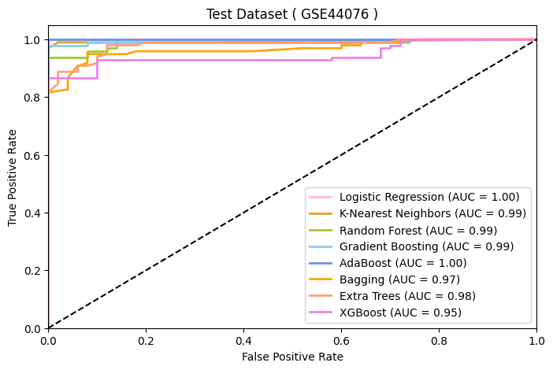
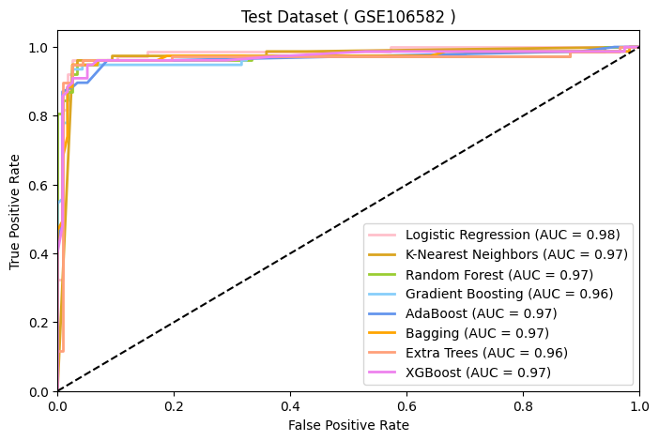
Result Evaluation (cont..)
Figure 5.2: AUC-ROC curve for Gene subsets (6 genes) for four test datasets (part-2)
Department Of Computer Science and Engineering, JnU
19

Slide 20
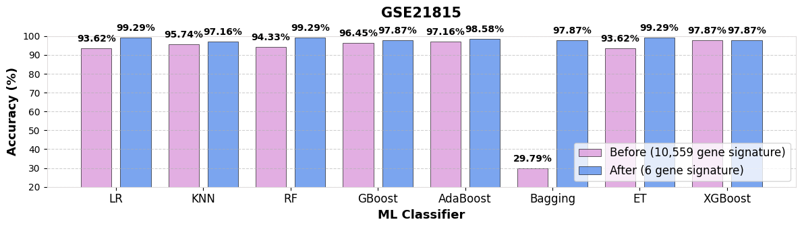
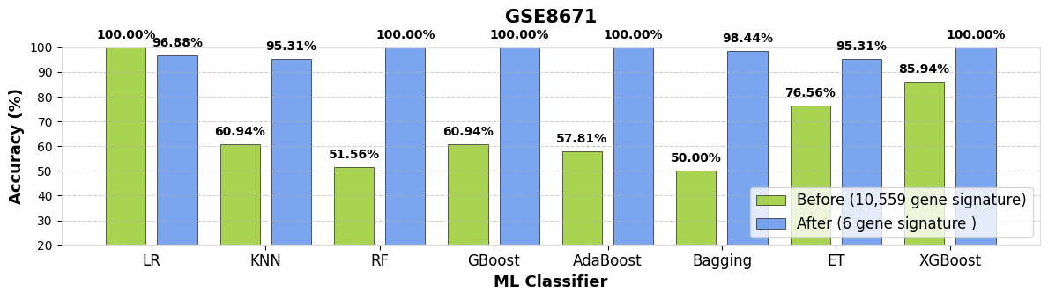
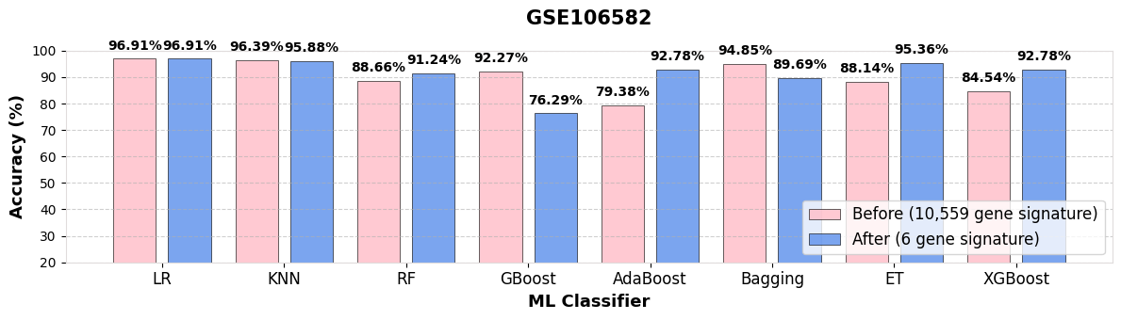
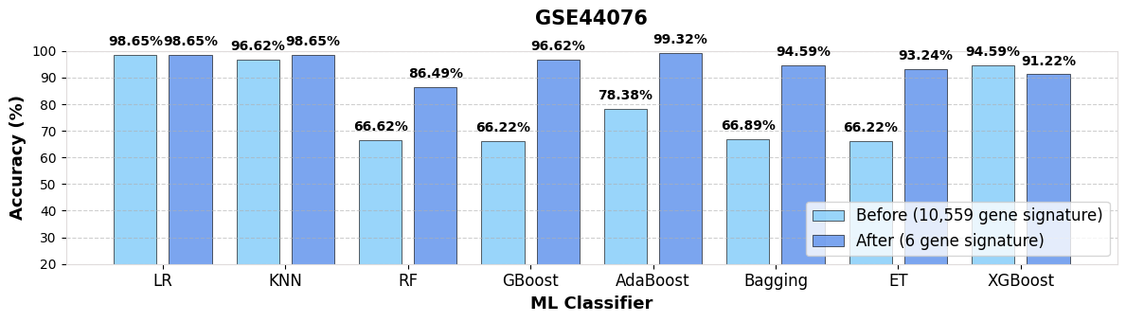
Result Evaluation (cont..)
Figure 5.3 : Accuracy comparison of all features vs selective features for 4 datasets
Department Of Computer Science and Engineering, JnU
20

Slide 21
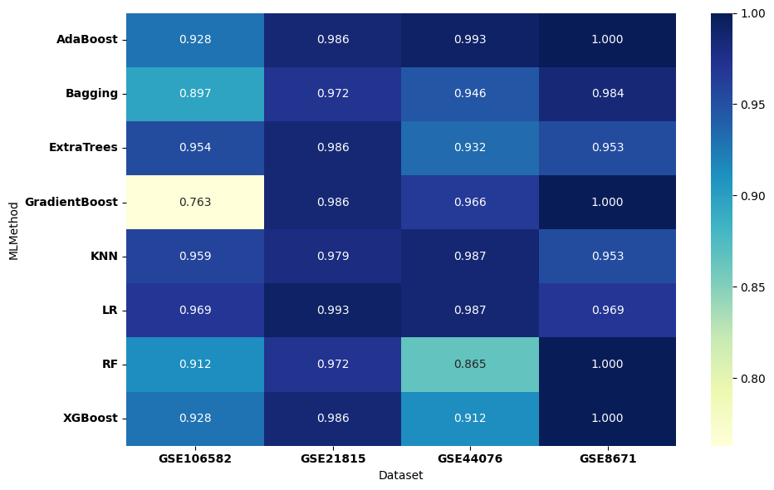
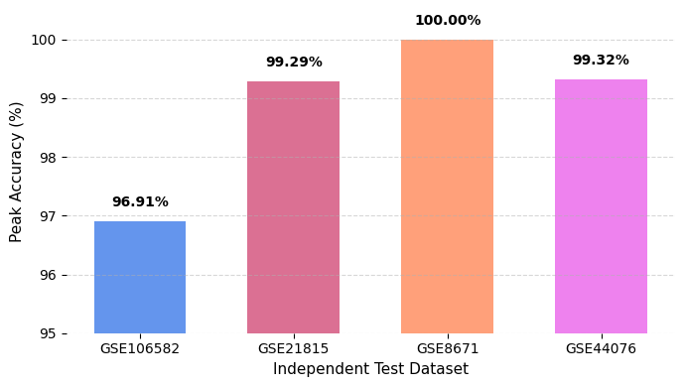
Result Evaluation (cont..)
Figure 5.4: Accuracy of ML Models within 4 test Datasets
Figure 5.5 : Peak accuracy with 6 candidate gene signature
Department Of Computer Science and Engineering, JnU
21

Slide 22
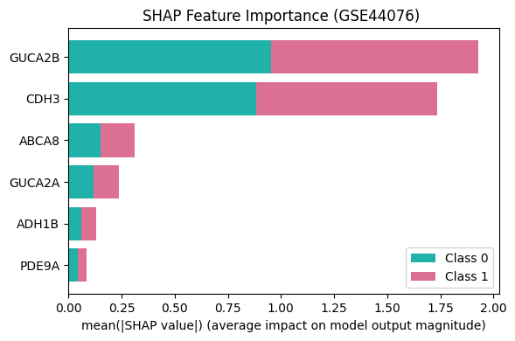
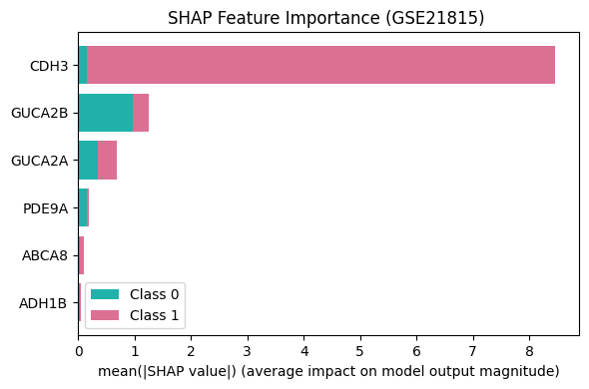
Model Interpretation
Figure 6.1: SHAP stacked bar chart for four independent test datasets(part-1).
Department Of Computer Science and Engineering, JnU
22

Slide 23
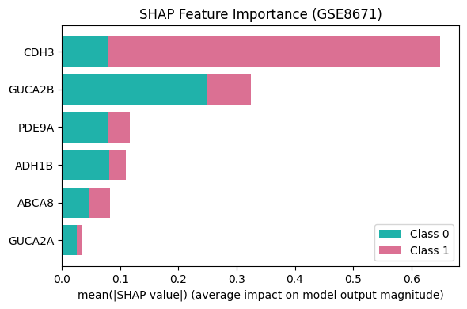
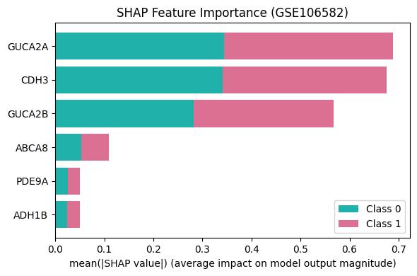
Model Interpretation (cont..)
Figure 6.2: SHAP stacked bar chart for four independent test datasets (part-2).
Department Of Computer Science and Engineering, JnU
23

Slide 24
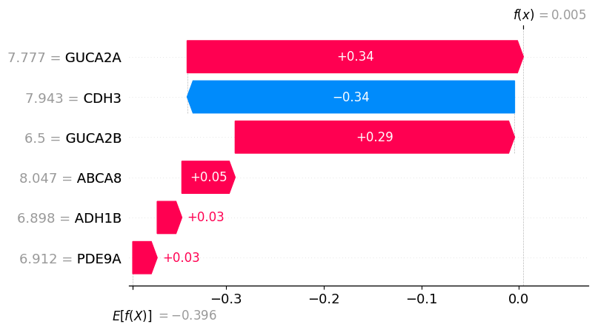
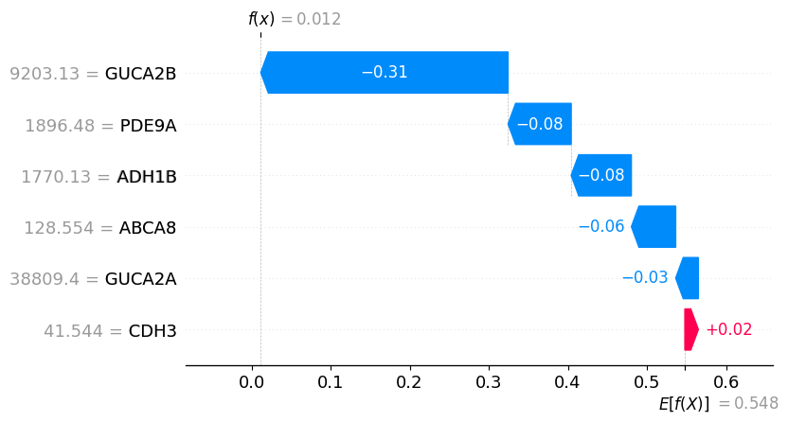
Model Interpretation(Cont..)
(a)
(b)
Figure 6.3 : SHAP Waterfall chart for 4 independent test datasets: (a) GSE106582, (b) GSE8671 (part-1).
Department Of Computer Science and Engineering, JnU
24

Slide 25
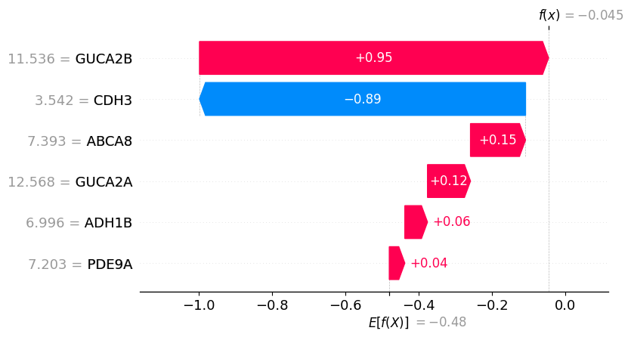
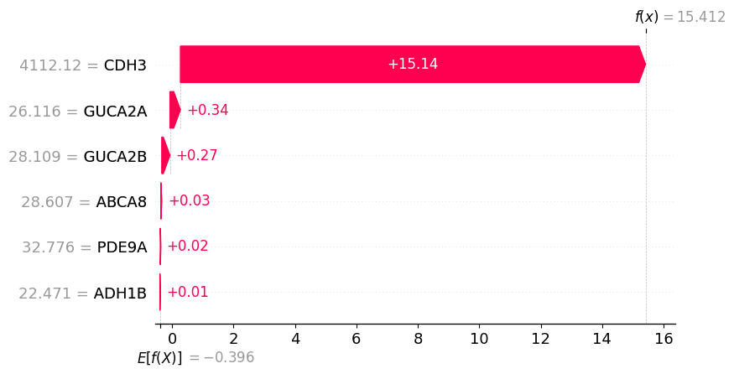
Model Interpretation(Cont..)
(c)
(d)
Figure 6.4 : SHAP Waterfall chart for 4 independent test datasets: (c) GSE44076, (d) GSE21815 (part-2).
Department Of Computer Science and Engineering, JnU
25

Slide 26
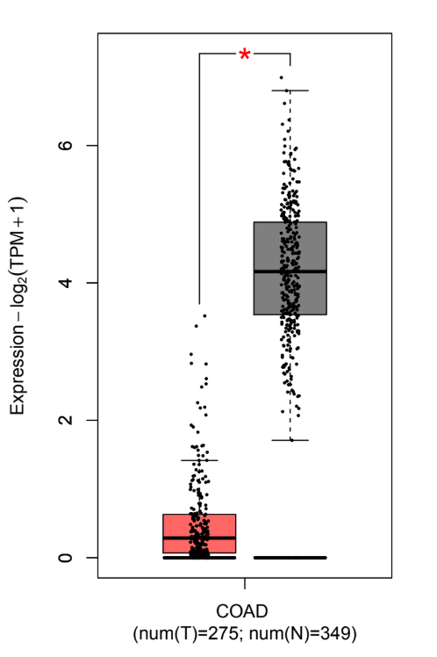
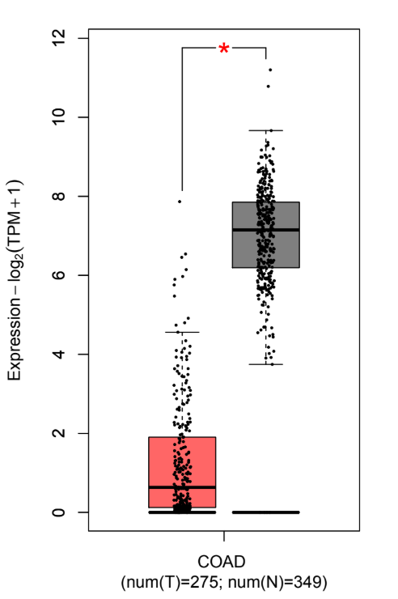
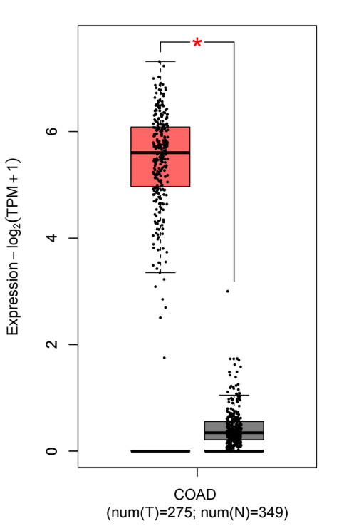
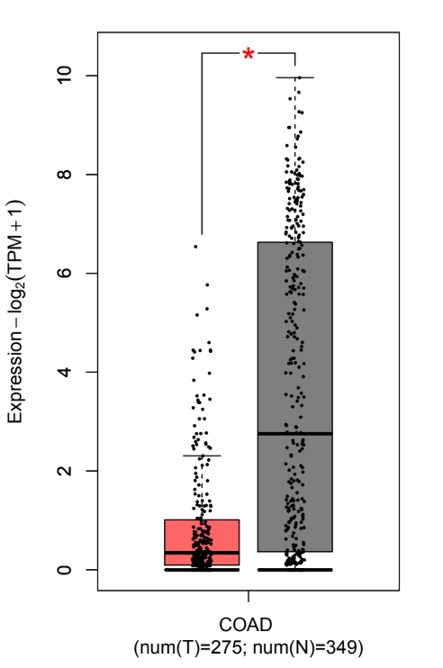
Gene Validation
(a) ABCA8
(b) ADH1B
(c) CDH3
(d) GUCA2A
Figure 7.1 : Validating 6 candidate genes using GEPIA2 (part-1)
Department Of Computer Science and Engineering, JnU
26

Slide 27
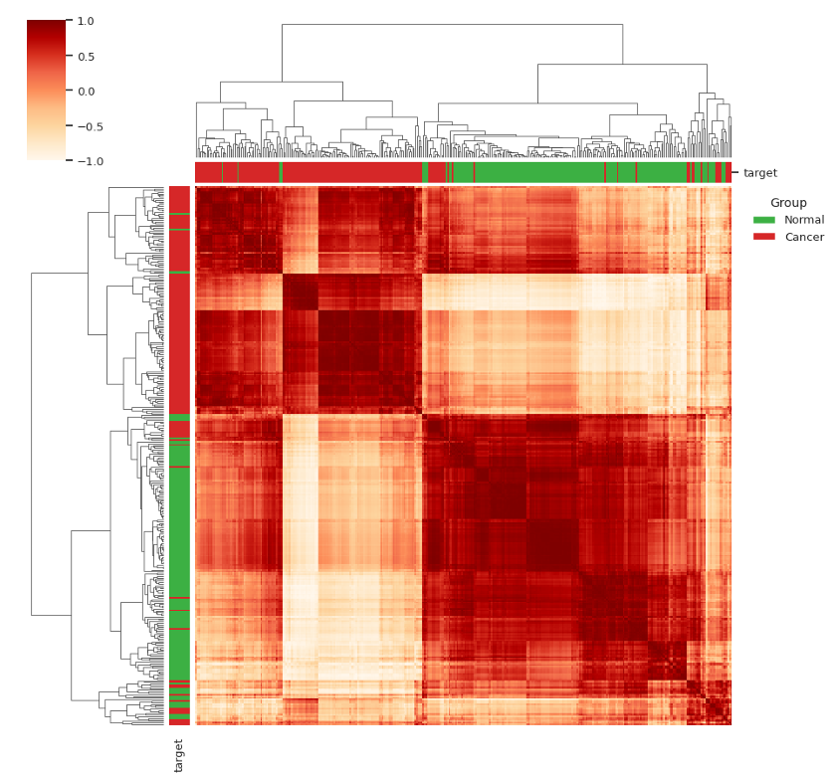
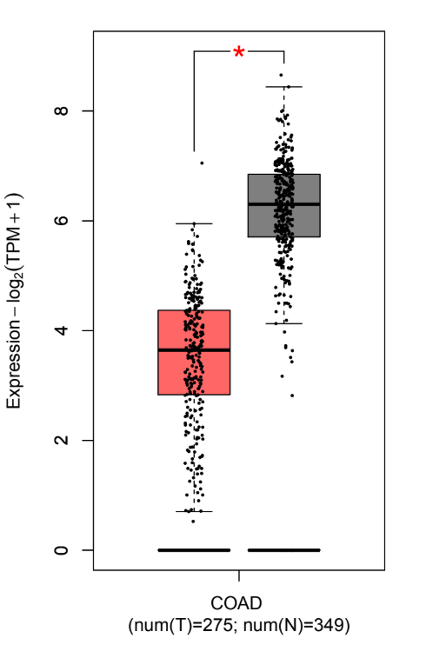
Gene Validation (cont..)
(e) GUCA2B
(f) PDE9A
Figure 7.2 : Validating 6 candidate genes using GEPIA2 (part-2).
Figure 7.3 : Unsupervised Sample Validation using Hierarchical Clustering with 6 candidate genes
Department Of Computer Science and Engineering, JnU
27

Slide 28
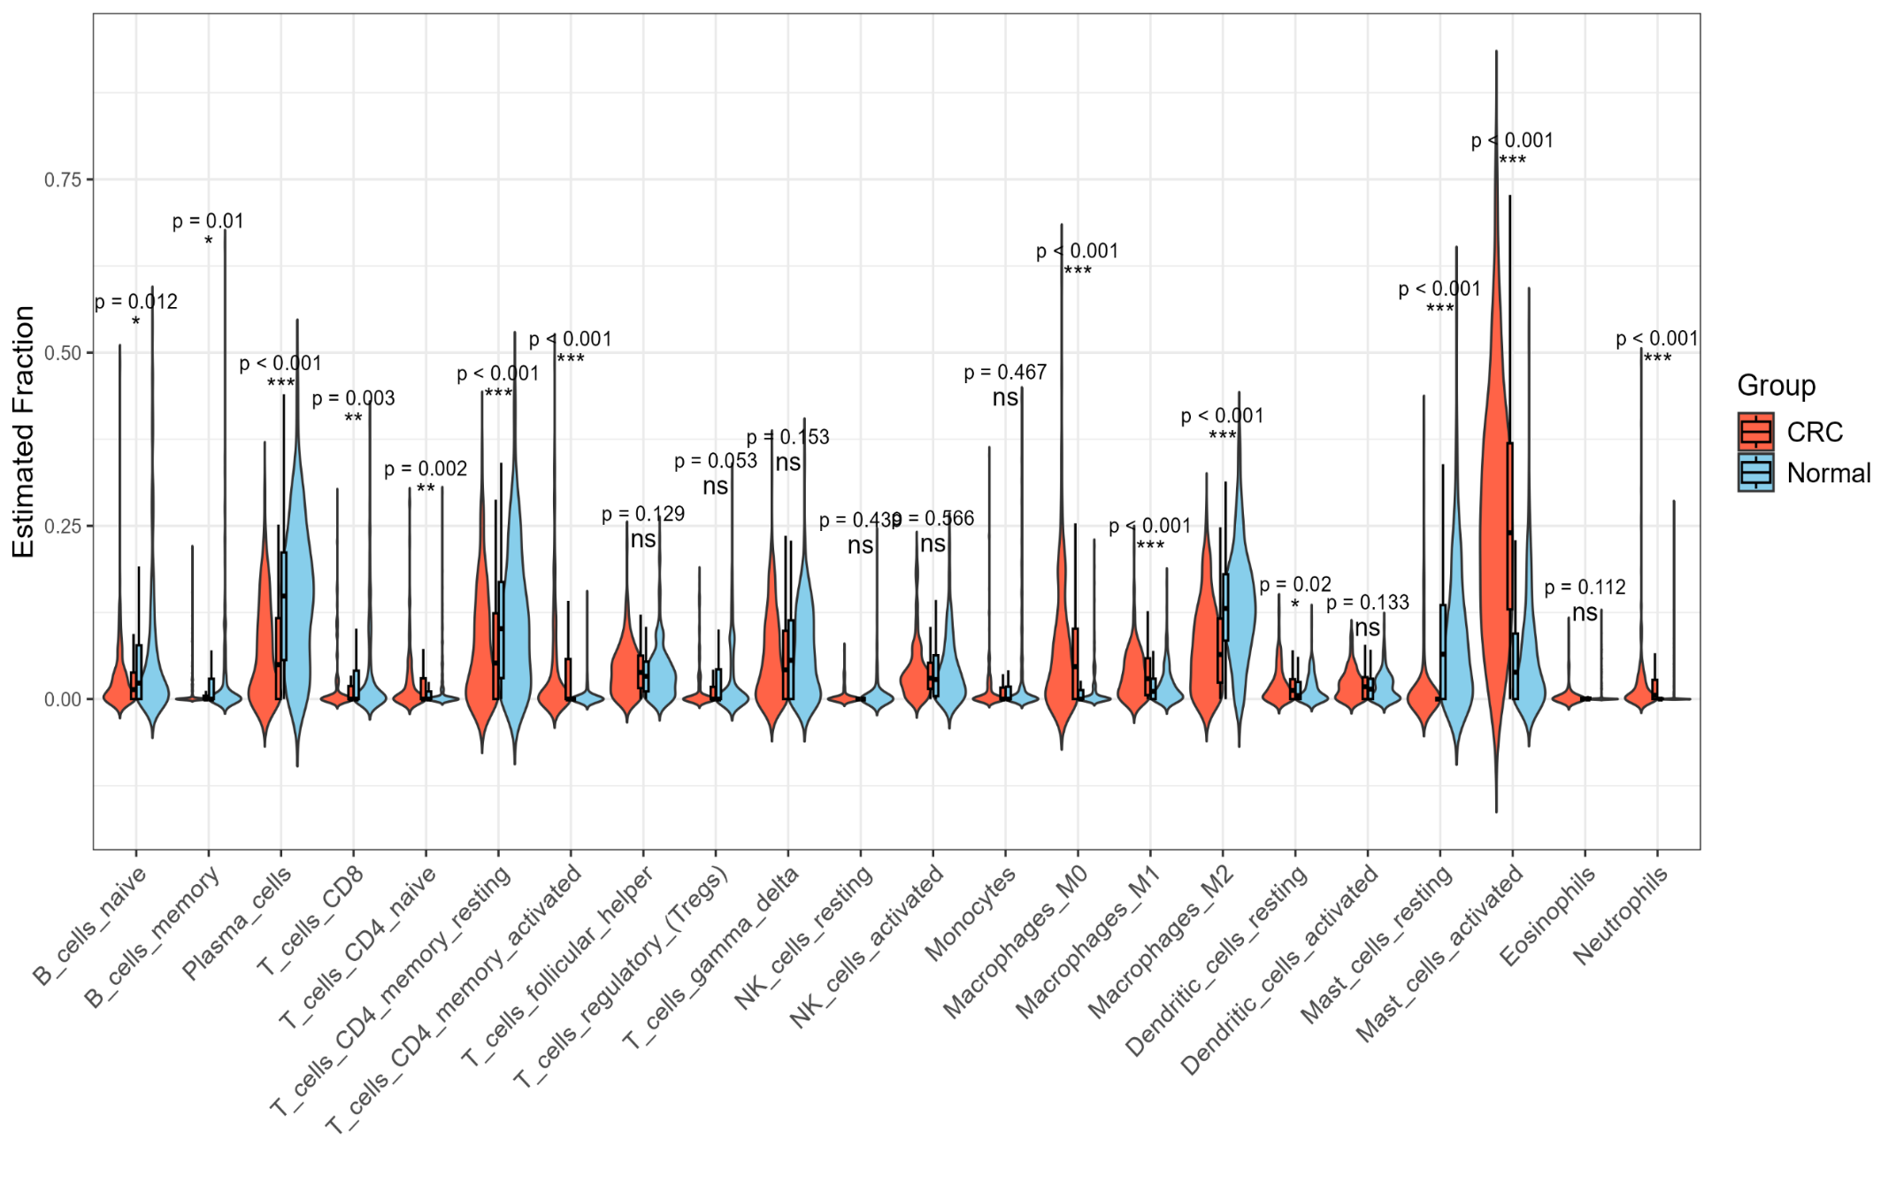
Immune Infiltration Analysis
Figure 7.4 : Violin plot differences in 22 types of immune cells
Department Of Computer Science and Engineering, JnU
28

Slide 29
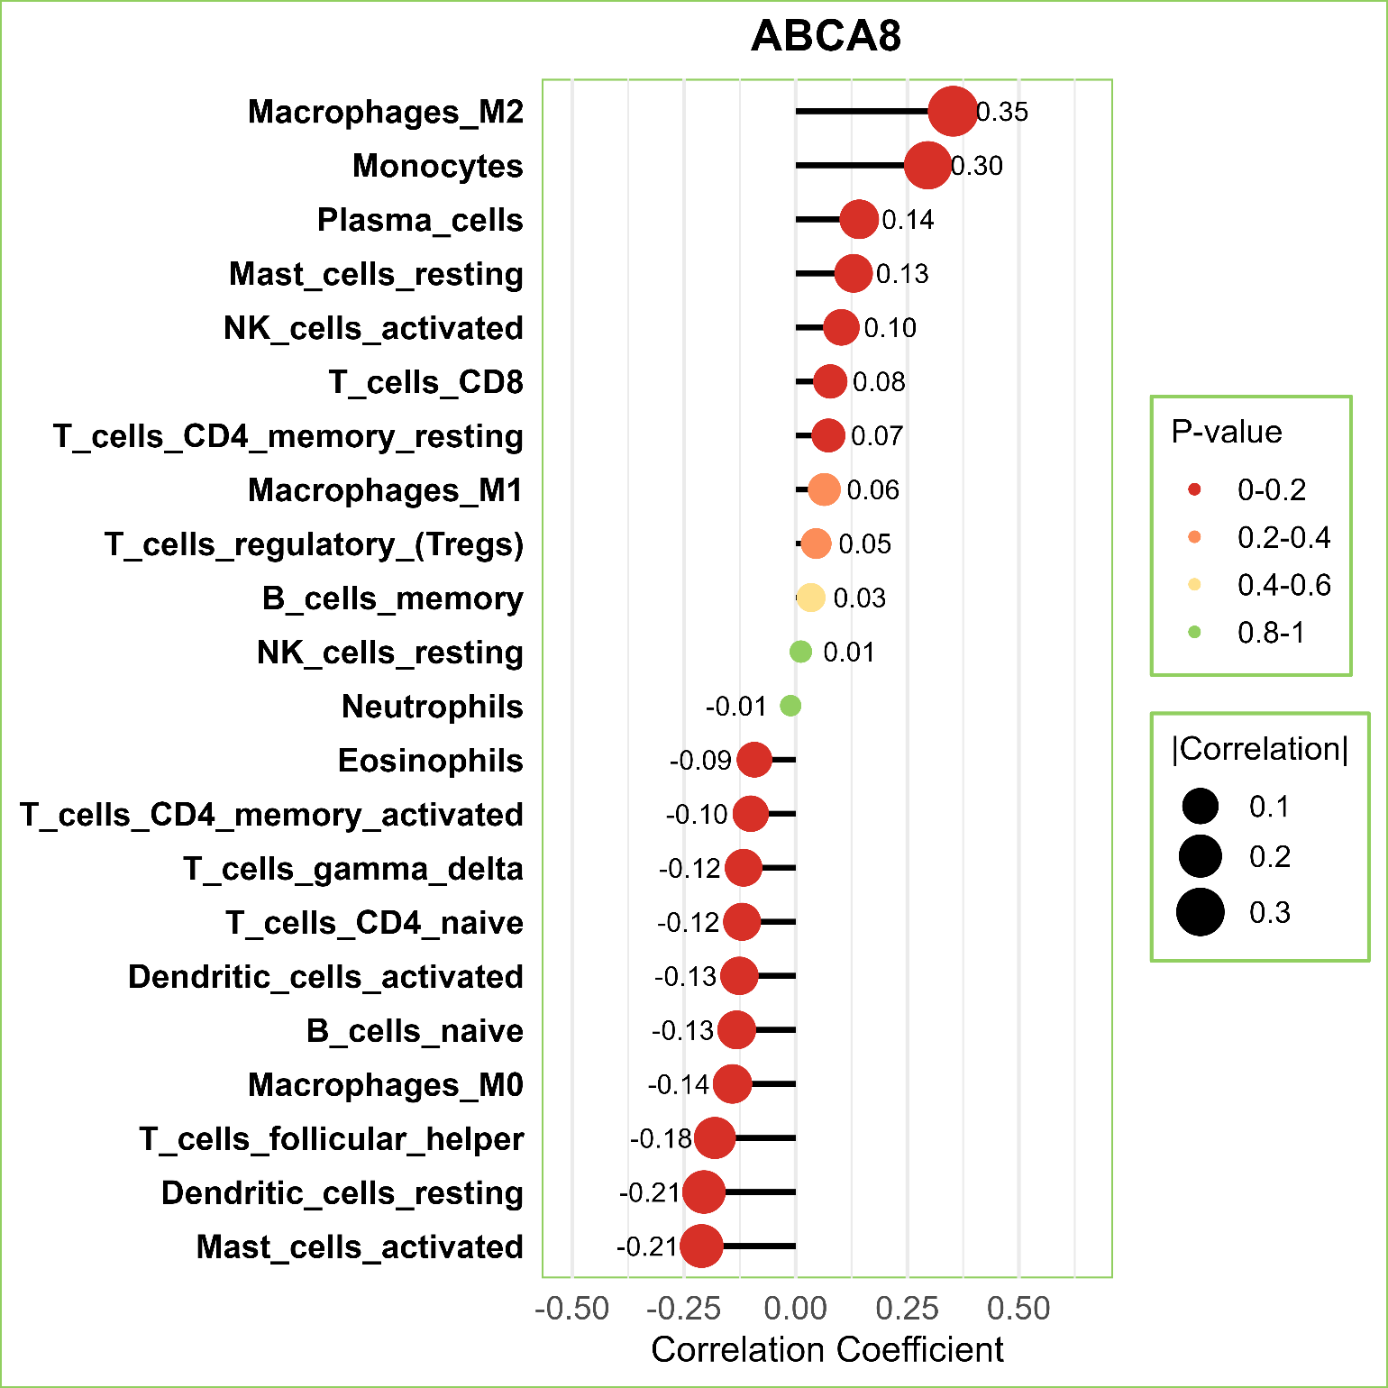
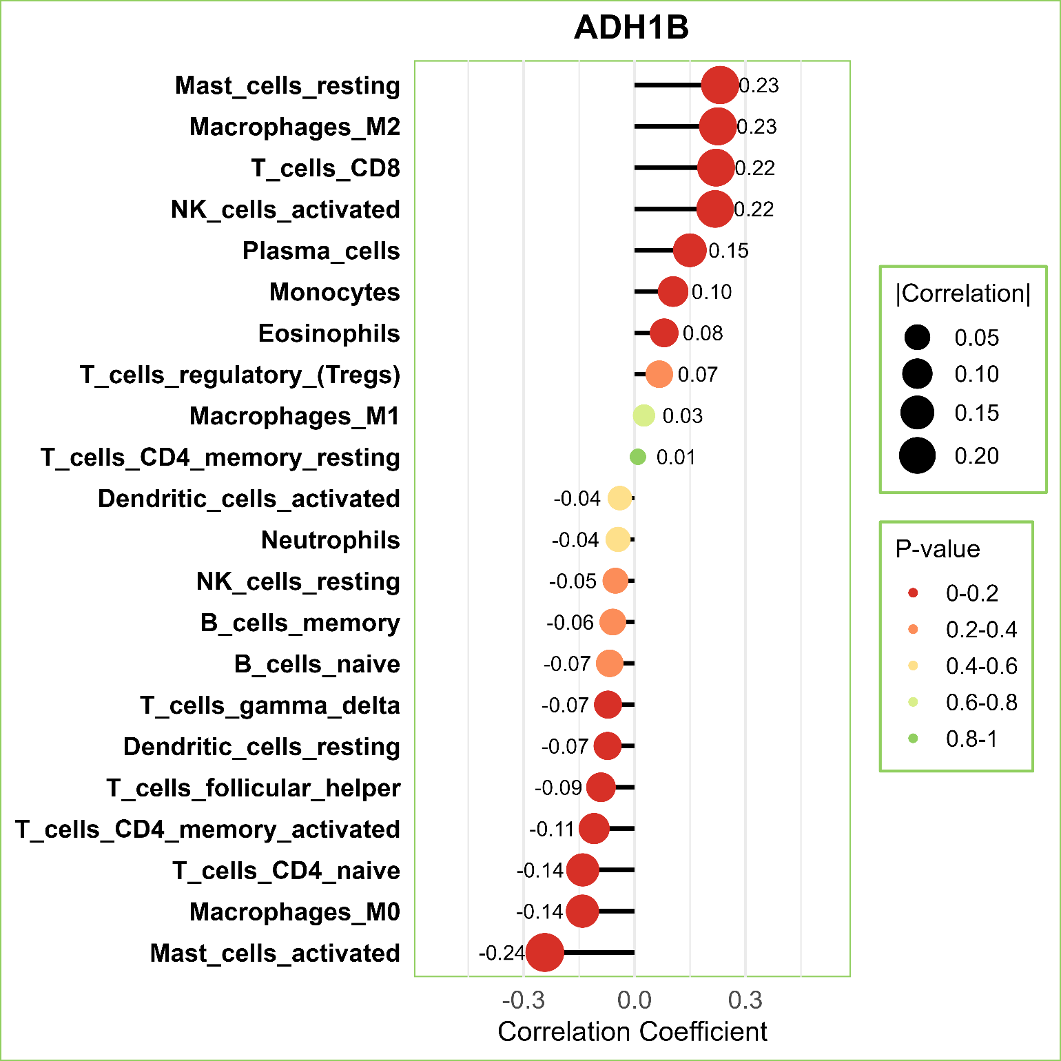
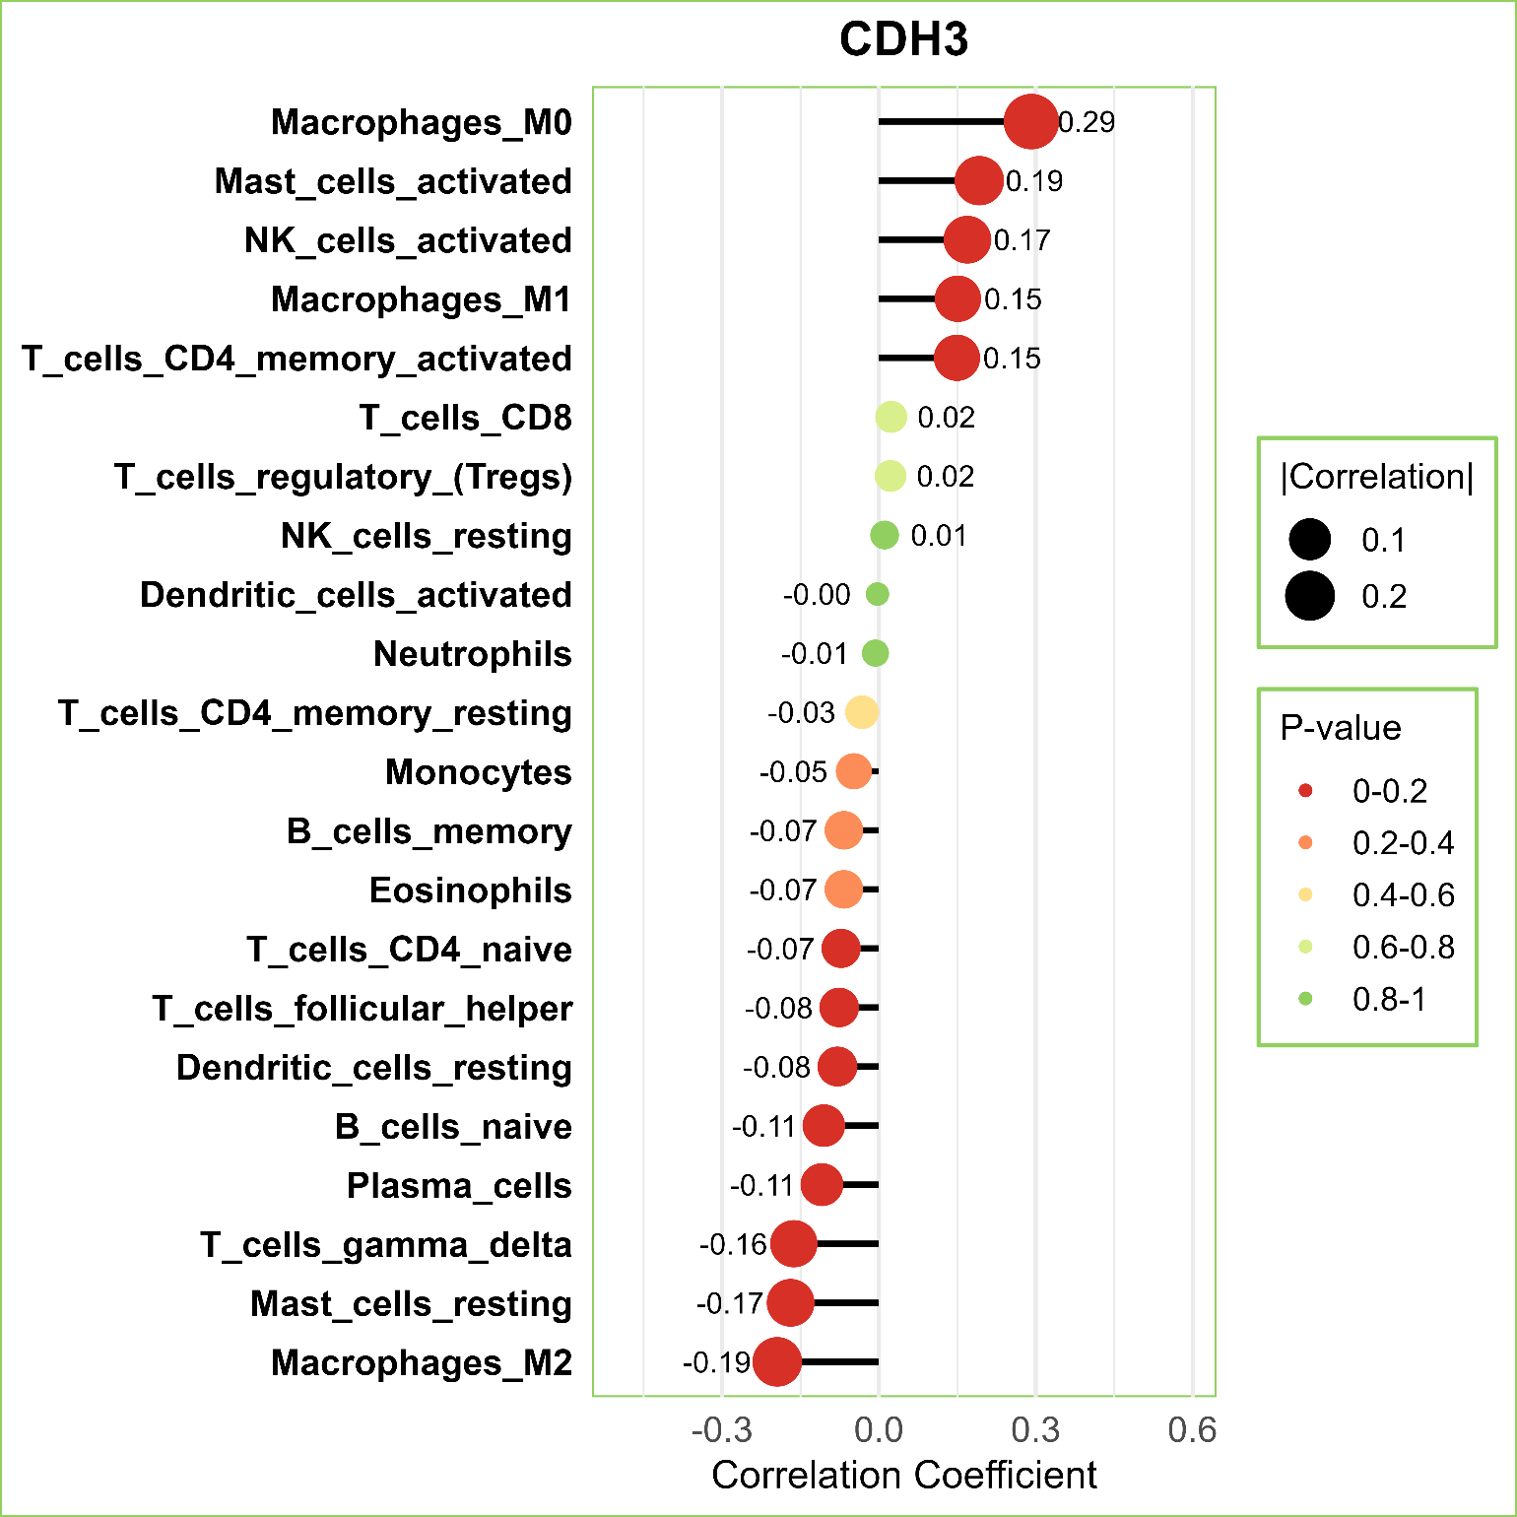
Immune Infiltration Analysis (cont..)
Figure 7.5 : Correlation between 6 diagnostic genes and immune cells (part-1)
Department Of Computer Science and Engineering, JnU
29

Slide 30
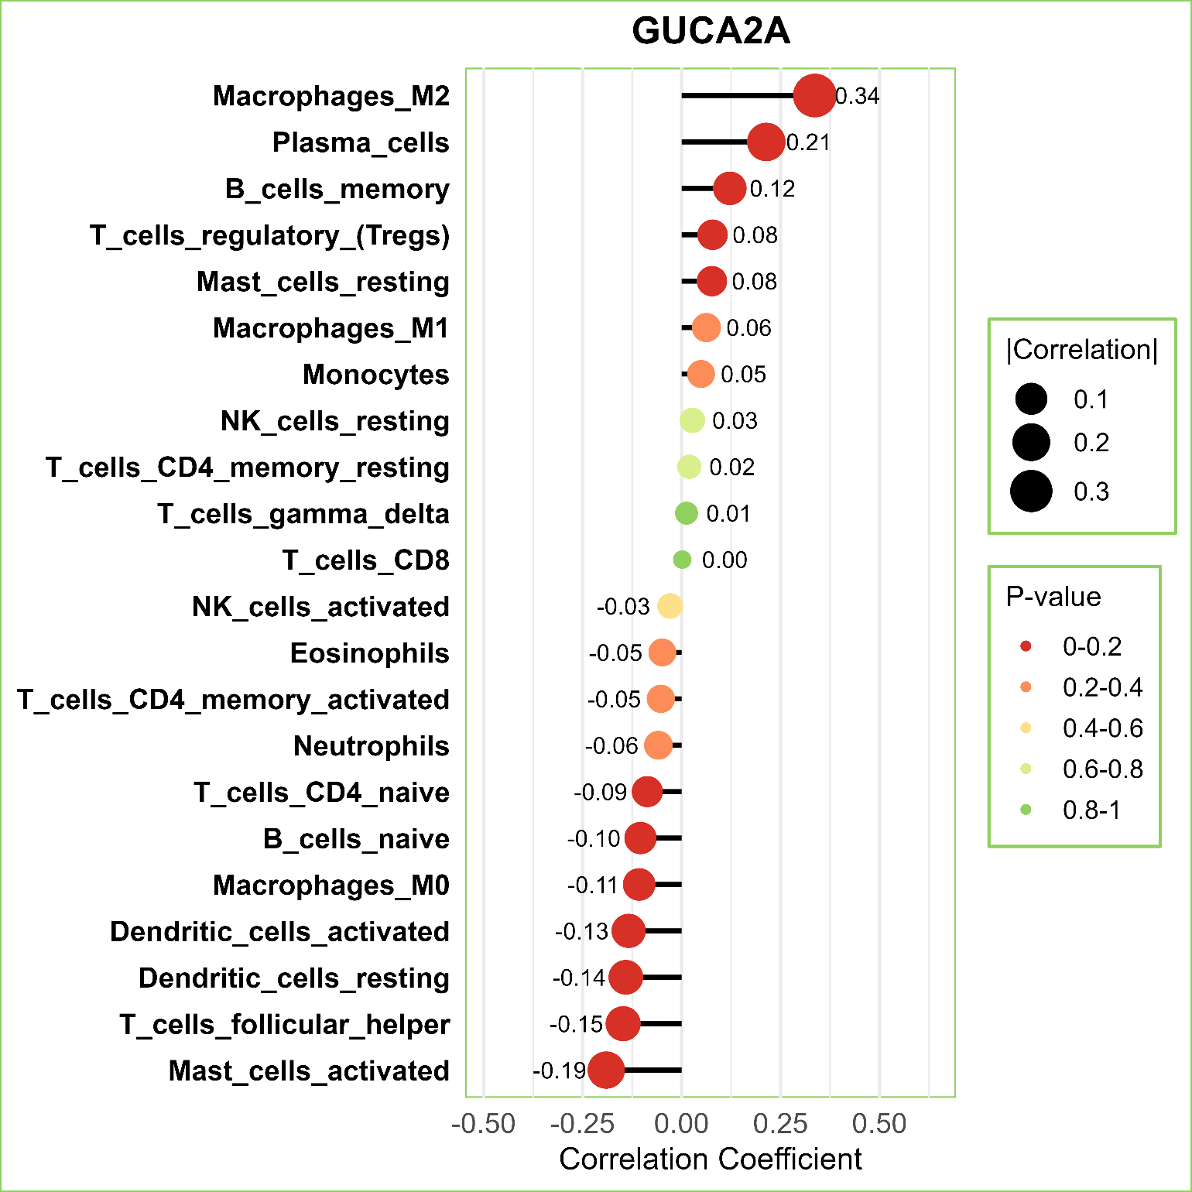
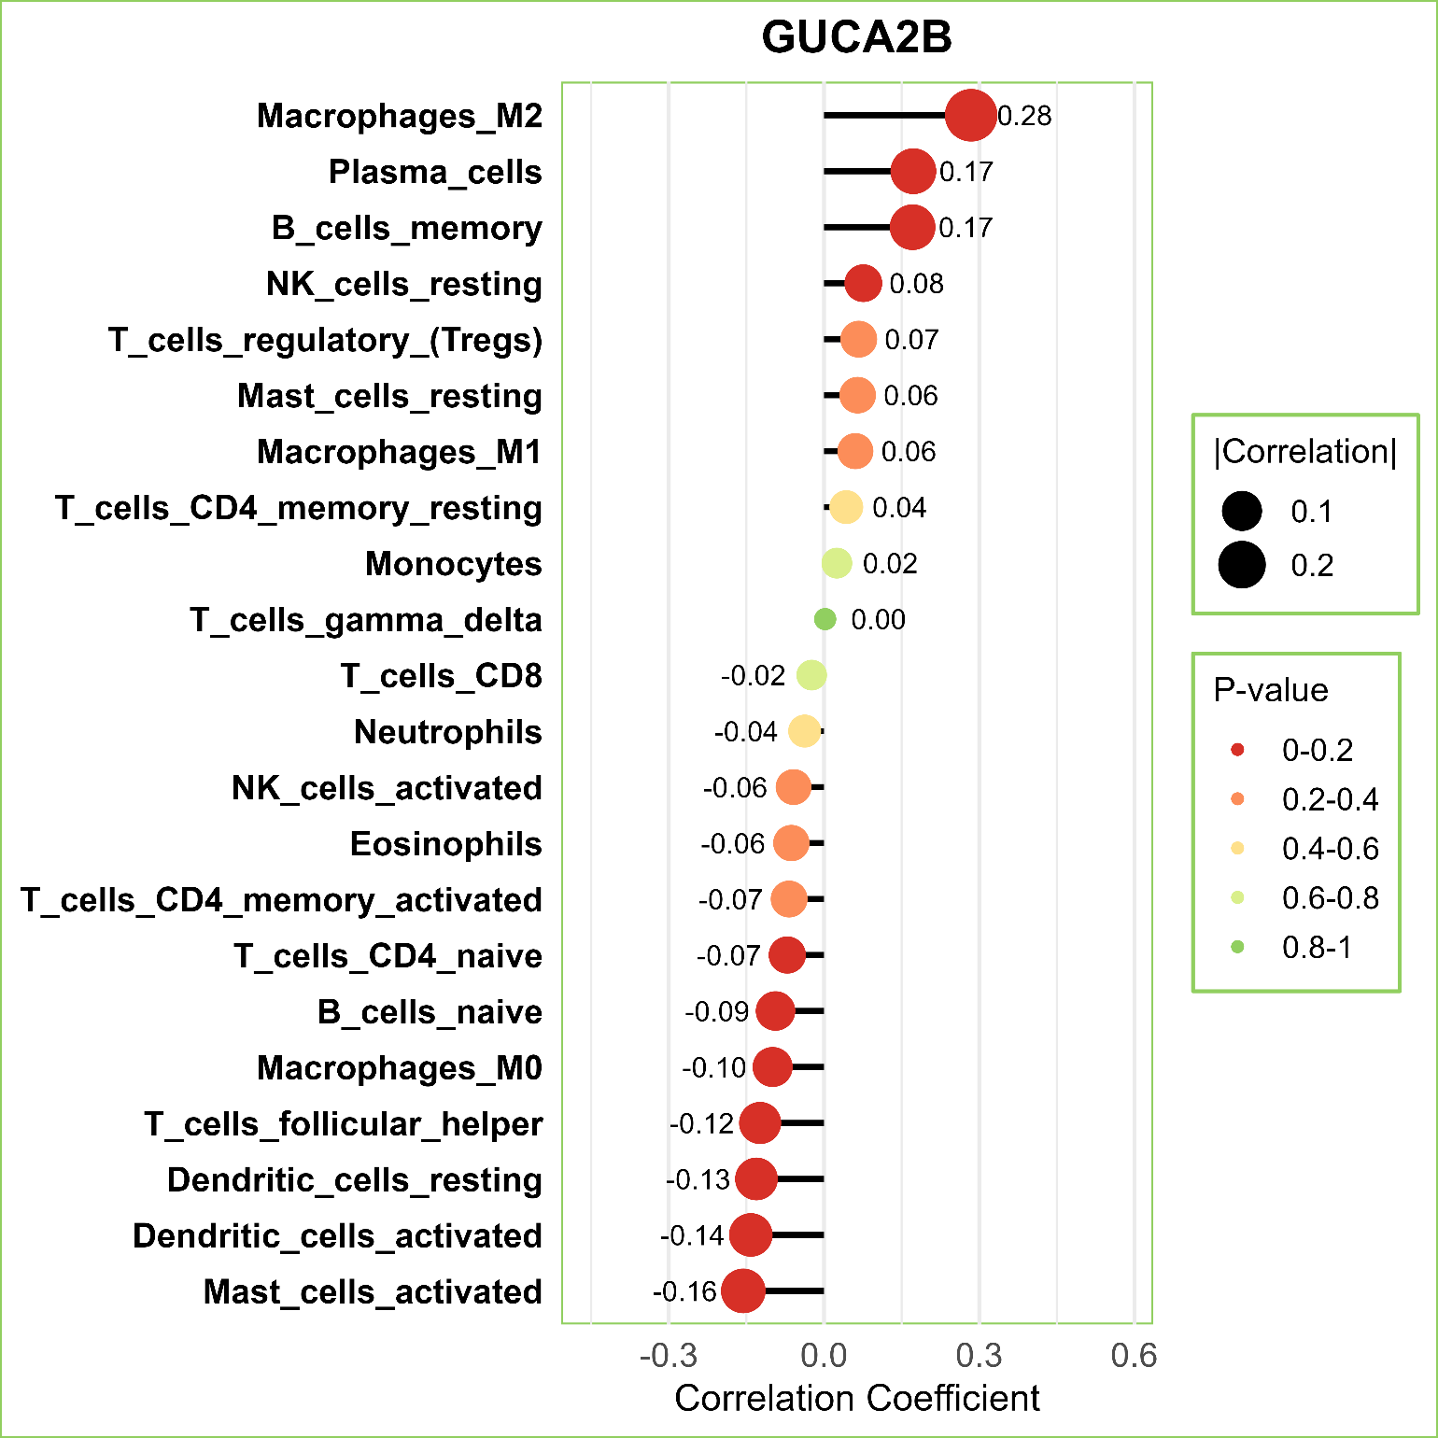
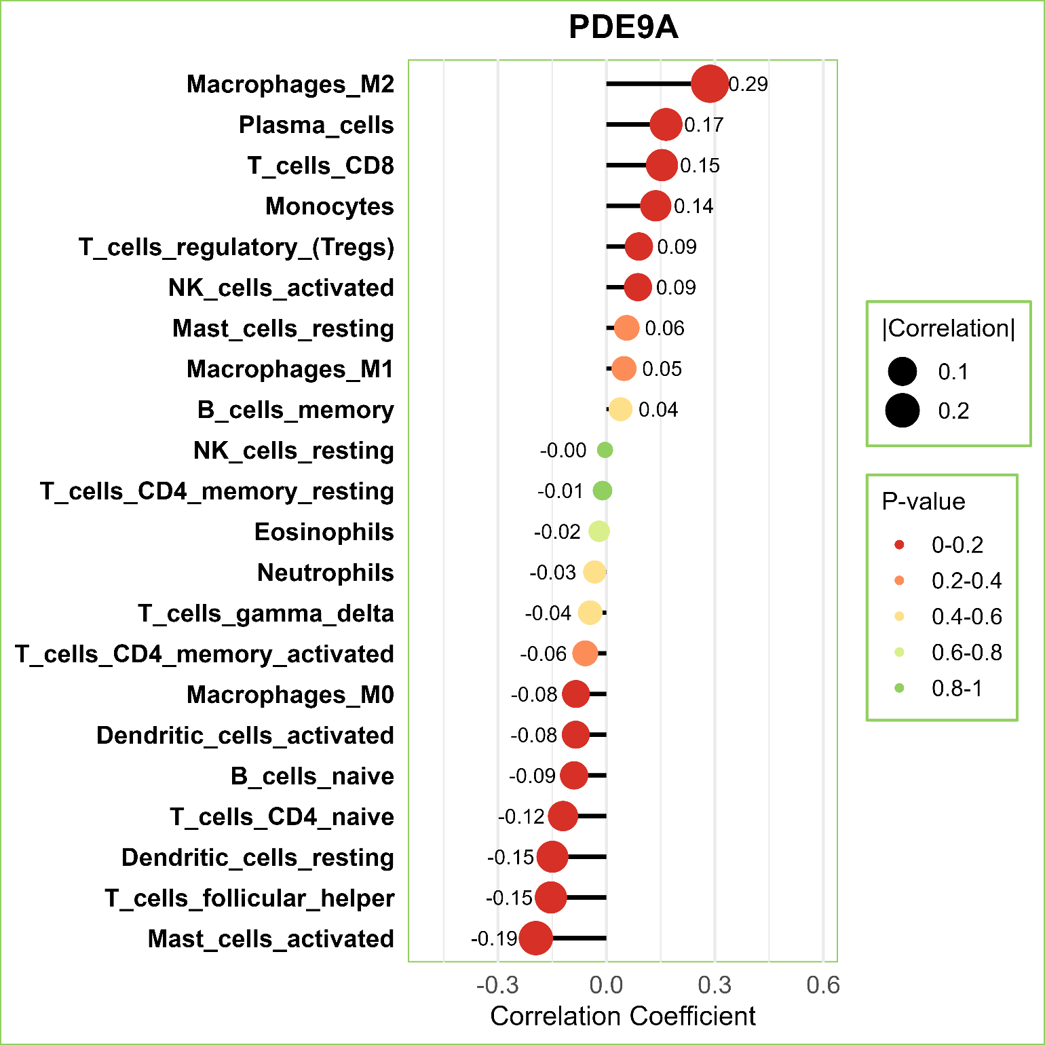
Immune Infiltration Analysis (cont..)
Figure 7.6 : Correlation between 6 diagnostic genes and immune cells (part-2)
Department Of Computer Science and Engineering, JnU
30

Slide 31
Comparative Study
Comparative study with related papers
Paper (Title) | Diagnostic Genes | Test Datasets | Accuracy
Integrating machine learning and bioinformatics approaches for identifying novel diagnostic gene biomarkers in colorectal cancer [3] | 11 | GSE106582, GSE21815 | 95.8%, 97.8%
A hybrid machine learning feature selection model—HMLFSM to enhance gene classification applied to multiple colon cancers dataset [4] | 68 | GEO at NCBI | 93.9%
Machine learning-based identification of colon cancer candidate diagnostics genes [5] | 34 | GSE20916, GSE44861 | 96.4%, 98.2%
Machine learning-based identification of proteomic markers in colorectal cancer using UK Biobank data [6] | 7 | UK Biobank data | 94.87%
Integrating relieff‑based feature selection and ensemble machine learning for robust biomarker identification in colorectal cancer [7] | 4 | GSE44076 | 97%
Our Study | 6 | GSE106582, GSE21815, GSE8671, GSE44076 | 96.91%, 99.29%, 100%, 99.32%
Table 8.1: Comparison with Related Papers
Department Of Computer Science and Engineering, JnU
31

Slide 32
Conclusion
An analytical framework is designed, implemented and evaluated. A combination of bioinformatics and machine learning approaches identified 6 influential gene signatures, including ADH1B, CDH3, GUCA2B, PDE9A, ABCA8 and GUCA2A.
4 independent test datasets are used to evaluate this research showing 96.91%, 99.29%, 100% and 99.32% accuracy.
The models are interpreted by Explainable AI i.e. SHAP features importance and SHAP waterfall chart.
Also , GEPIA2 was used to validate these 6 genes showing they are statistically significant (p value < 0.05).
Then immune infiltration was followed by these 6 genes. Consequently, these 6 biomarkers are anticipated as influential markers for CRC.
Department Of Computer Science and Engineering, JnU
32

Slide 33
References
[1] | https://www.wcrf.org/preventing-cancer/cancer-statistics/colorectal-cancer-statistics/
[2] | Sweeney SM, Hamadeh HK, Abrams N, Adam SJ, Brenner S, Connors DE, Davis GJ, Fiore LD, Gawel SH, Grossman RL, Hanlon SE, Hsu K, Kelloff GJ, Kirsch IR, Louv B, McGraw D, Meng F, Milgram D, Miller RS, Morgan E, Mukundan L, O'Brien T, Robbins P, Rubin EH, Rubinstein WS, Salmi L, Schaller TH, Shi G, Sigman CC, Srivastava S. Case Studies for Overcoming Challenges in Using Big Data in Cancer. Cancer Res. 2023 Apr 14;83(8):1183-1190. doi: 10.1158/0008-5472.CAN-22-1277. PMID: 36625851; PMCID: PMC10102839.
[3] | A. Vaziri-Moghadam and M. Foroughmand-Araabi, “Integrating machine learning and bioinformatics approaches for identifying novel diagnostic gene biomarkers in colorectal cancer,” Scientific Reports, vol. 14, p. 24786, 2024. [Online]. Available: https://www.nature.com/articles/s41598-024-75438-6
[4] | M. Al-Rajab, J. Lu, Q. Xu, M. Kentour, A. Sawsa, E. Shuweikeh, M. Joy, and R. Arasaradnam, “A hybrid machine learning feature selection model—hmlfsm to enhance gene classification applied to multiple colon cancers dataset,” PLOS ONE, vol. 18, no. 11, pp. 1–27, 11 2023. [Online]. Available: https://doi.org/10.1371/journal.pone.0286791
[5] | S. Koppad, A. Basava, K. Nash, G. V. Gkoutos, and A. Acharjee, “Machine learning-based identification of colon cancer candidate diagnostics genes,” Biology, vol. 11, no. 3, 2022. [Online]. Available: https: //www.mdpi.com/2079-7737/11/3/365
Department Of Computer Science and Engineering, JnU
33

Slide 34
References (Cont..)
[6] | S. K. Radhakrishnan, D. Nath, D. Russ, L. B. Merodio, S. Lad, F. Daisi, and A. Acharjee, “Machine learning-based identification of proteomic markers in colorectal cancer using uk biobank data,” Frontiers in Oncology, 2025.
[7] | P. Bera, S. Debnath, C. Mal et al., “Integrating relieff-based feature selection and ensemble machine learning for robust biomarker identification in colorectal cancer,” Network Modeling Analysis in Health Informatics and Bioinformatics, vol. 14, p. 40, 2025. [Online]. Available: https: //doi.org/10.1007/s13721-025-00533-1
[8] | H. L. Hyelim Chun, Minha Lea Yoon, J. Y. L. Woo Jeong Seo, and J. H. Yoon, “Identification and validation of serum biomarkers to improve colorectal cancer diagnosis,” Cancer Medicine, vol. 13, no. 23, p. e70460, 2024
[9] | M. A. M. Hasan, M. Maniruzzaman, and J. Shin, “WGCNA and machine learning-based integrative bioinformatics analysis for identifying key genes of colorectal cancer,” IEEE Access, vol. 12, pp. 144 350–144 363, 2024. [Online]. Available: https://doi.org/10.1109/ACCESS.2024.3472688
[10] | X. Du, H. Qi, W. Ji, P. Li, R. Hua, W. Hu, and F. Qi, “Construction of a colorectal cancer prognostic risk model and screening of prognostic risk genes using BIBLIOGRAPHY 155 machine-learning algorithms,” Journal of Healthcare Engineering, p. 9408839, 2022.
Department Of Computer Science and Engineering, JnU
34

Slide 35




THANK YOU
Department Of Computer Science and Engineering, JnU
35

